Slide 1
Board Retreat 2015

Slide 2
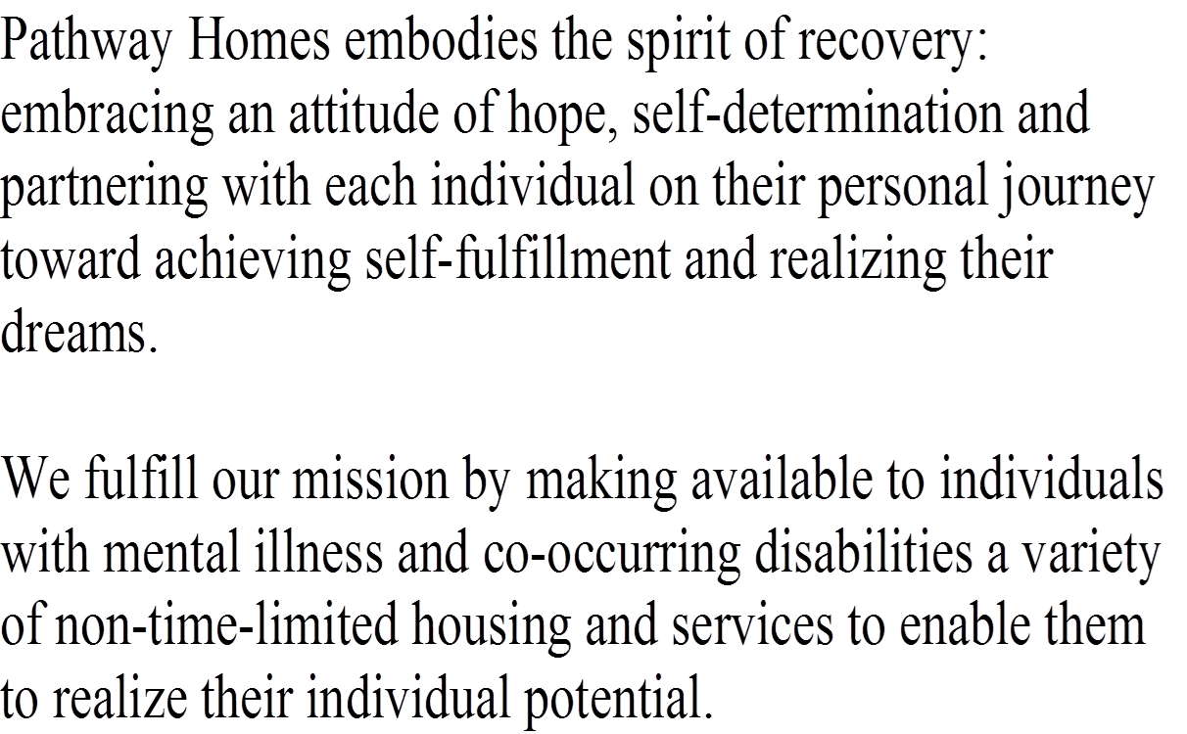
Mission Statement

Slide 3
Vision Statement
The Vision of Pathway Homes is to create a future in which all individuals with mental illness and co-occurring disabilities are able to lead meaningful, self-directed lives in a home of their choice with the supports and services they need.

Slide 4
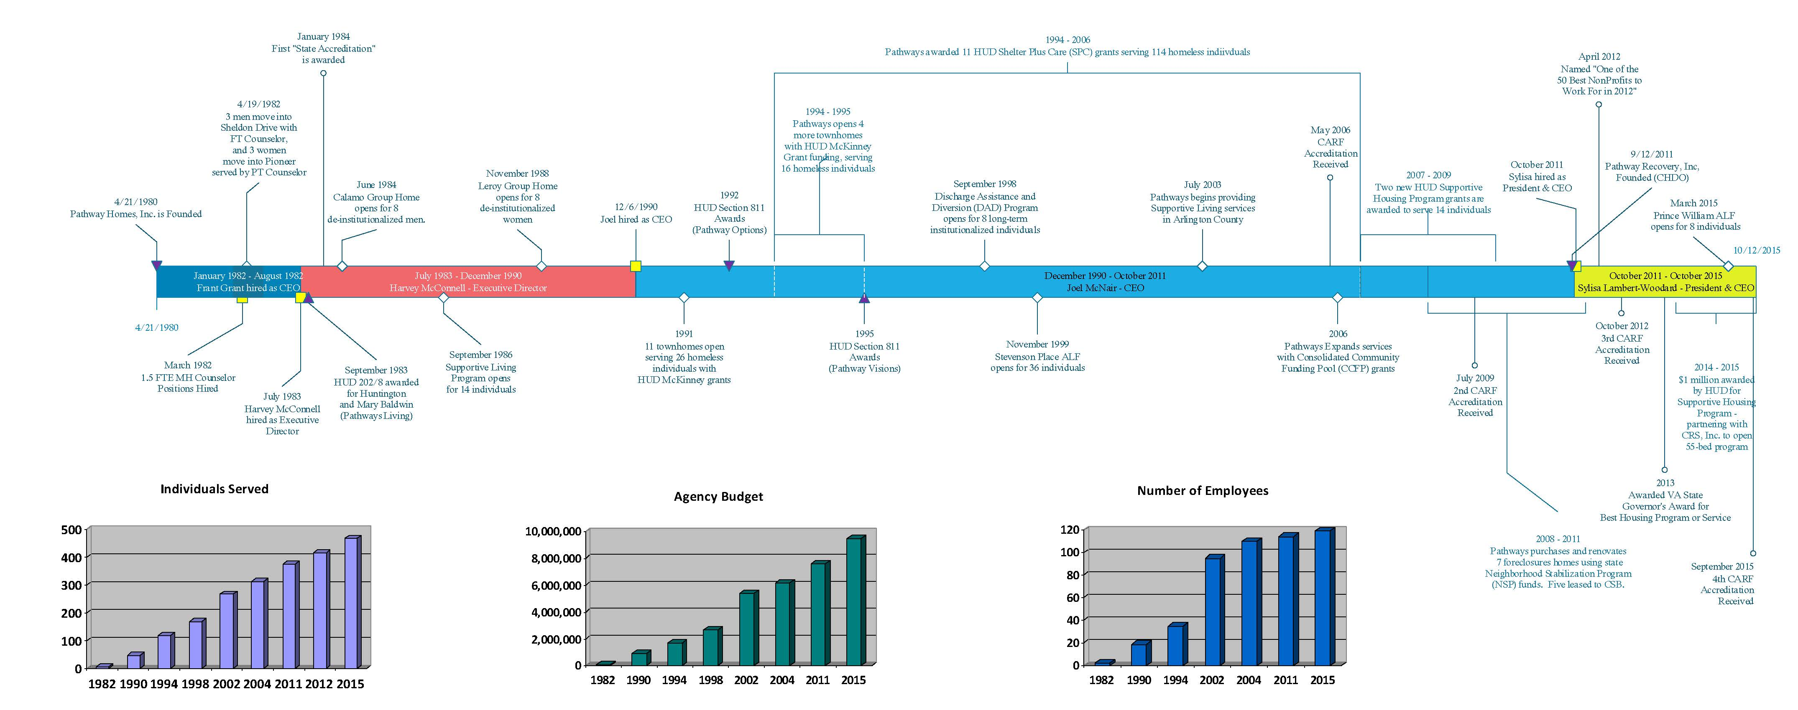

Slide 5
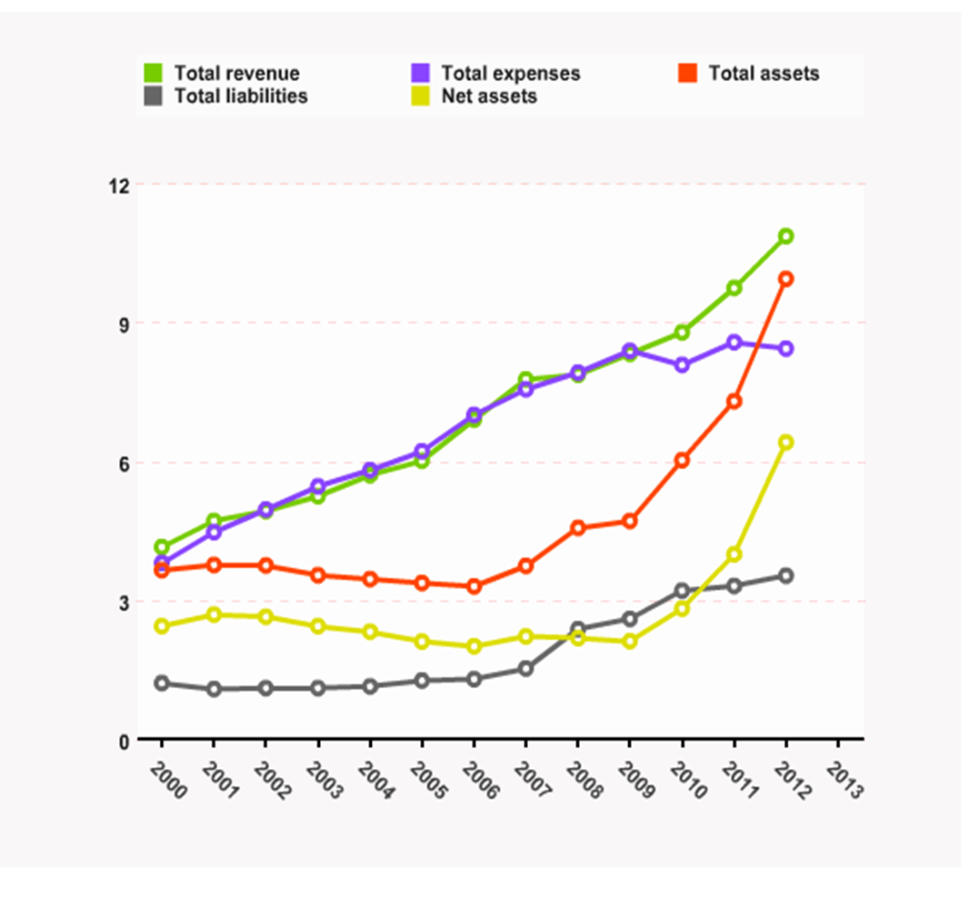
Pathway Homes Growth 2000-2013
Ref: Connect Virginia (http://connectnorthernvirginia.org/communityplatform/nova/organization/profile/id/541041459)

Slide 6
Recovery
Client Services and Healthcare
Acquisition and Development
Education and Advocacy
Notes:
Paths to Recovery

Slide 7
Strategic Goals
Increase housing stock and recovery-based services.
Maintain competent, qualified and satisfied workforce.
Market Pathway Homes as a best practice organization and develop supportive partnerships.
Ensure financial health and long-term viability of the organization.

Slide 8
Strategic Plan Objectives
Information Technology
Recovery
Growth
Human Resources
Communication

Slide 9
Strategic Plan Objectives In Progress
RECOVERY: Explore development of Consumer Speaker’s Bureau/Train Council members.
GROWTH: Conduct DDCMHT assessment of agency.
GROWTH: Roll out DD staff training following agency assessment.
HR: Develop recommendations to improve recruitment and hiring practices.
COMMUNICATION: Educate staff about agency programs and services.

Slide 10
FORECASTING
Forecasting is the process of making predictions of the future based on past and present data and analysis of trends. A commonplace example might be estimation of some variable of interest at some specified future date.

Slide 11
“Whether” report
  Pathway services are increasingly required to produce qualitative and quantitative data to substantiate best practices, and remain competitive in our emerging marketplace. We must demonstrate our return on investment to remain “the preferred provider” for residential services.

Slide 12
Agency Preview
Pathway Homes continues to expand through service delivery, housing and acquisition, and advocacy and education efforts and is now expanding to Prince William and emerging into Central Florida. Loudoun and DC are on the horizon.
To support this growth and expansion, agency staff must be properly supervised, trained, and supported.
Talent management tools are implemented, but not fully integrated into our culture to ensure readiness for the future.

Slide 13
Key challenges
Pathways continues to have a growing waitlist for services.
Continued salary disparity between Pathways and comparable clinical positions in the CSB
Ensuring adequate infrastructure for growth
Hiring and retaining qualified clinical staff
Relative overdependence on public funding
Flat line funding and increasing costs
Maximizing operational efficiencies and effectiveness
Inflexible or unfair legislative mandates that impact service growth (MHSB, CM)

Slide 14
Key Challenges
Our population is aging in place
Increased competition and increased accountability of services through outcomes are essential
Profits are sufficient to sustain operations, but working capital continues to be a challenge in maintaining sufficient growth opportunities

Slide 15
Notes:
This study is aimed at establishing baseline metrics to provide insight on how agencies are occupying and utilizing their work environments. These baseline metrics can prove to be very helpful guides to growing agencies and established social enterprises.
The information obtained from this survey will be shared with you in a detailed report produced by SLW, which will be on the board portal. The results will allow Pathways Board to better understand trends, challenge thereby allowing them to make more informed decisions.

Slide 16

Forecasting growth
GeeskeS animation on YouTube: https://www.youtube.com/watch?v=kYcIkOTqtcc

Slide 17
Forecasting growth…
SERVICES – Mental Health
Existing:
Provide services to 50 individuals in PW County by 2020
Provide services to 550 individuals by 2020 in Fairfax County.
Resume contract of DAD (ICRT) program.

Slide 18
Forecasting growth…
SERVICES – Mental Health
Emerging:
Provide services to 50 individuals in Florida by 2020
Develop gero-psych capacity
Develop co-occurring capacity
ICF-ID
Crisis Stabilization
DC
Loudoun
Social Bonds

Slide 19
Forecasting growth…
SERVICES – Housing
Develop a full continuum of residential services in Prince William County
Develop and/or partner with other community providers to purchase or develop 100 new homes by 2020
Eradicate homelessness among those with mental health disabilities and co-occurring disorders in Fairfax-Falls Church Community so that access to housing and support services are available within weeks instead of years.

Slide 20
Forecasting growth…
BEST-PRACTICES
Replicate consumer-directed housing model throughout the agency
Replicate Pathway Homes services regionally, nationally, and internationally

Slide 21
Forecasting growth…
ADVOCACY AND EDUCATION
Create new legislation to ensure parity, case management service funding, and a competitive marketplace for private providers to compete and drive down costs while increasing quality and efficiencies

Slide 22
Forecasting growth…
CAPACITY AND EFFICIENCY
50% decrease of current waitlist of 500 by 2020
Double current fundraising goal to $400,000 by 2020
IT infrastructure fully maximized and integrated with contract agencies, and emerging markets of service delivery
Human Resources and Leadership Team redesign

Slide 23
AGENCY BUDGET

Slide 24
Fully realizing the mission of Pathway Homes is not only possible, but highly probable!

