Slide 1
FY2017 State of the Agency
Presented: October 2, 2017

Slide 2
Mission

Slide 3
Vision Statement
The Vision of Pathway Homes is to create a future in which all individuals with mental illness and co-occurring disabilities are able to lead meaningful, self-directed lives in a home of their choice with the supports and services they need.

Slide 4
Pathways at a Glance
Recovery
Client Services and Healthcare
Acquisition and Development
Education and Advocacy

Slide 5
TRENDS IMPACTING PERSONNEL
Loss of Fairfax CSB sole source contract resulted in:
Loss of direct service staff positions
Hold on merit increases
Elimination of TSA discretionary employer match
Hold on tuition reimbursement lottery
Salary reductions for President & CEO, Leadership Team, and some clinical positions

Slide 6
Healthcare Services

Slide 7
181 New Individuals Served! Most significant increase in our history!
FY 2016
FY 2017
Total served 562​
Housing and svcs 451​
Housing only 42​
Housing only (DBHDS) 11​
Deployed contract 45​
Svcs only (Florida) 13​
Age range: 22-83​
Total served 743
Housing and svcs 536
Housing only 42
Housing only (DBHDS) 42
Deployed contract 45
Svcs only (Florida) 120
Age range: 21-84
Notes:
UPDATED

Slide 8
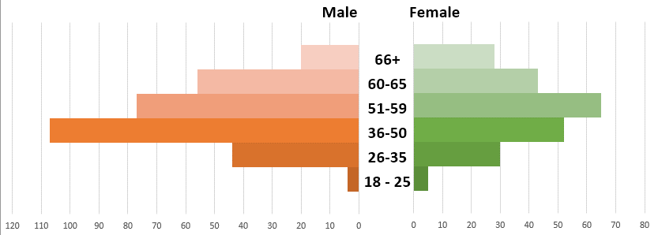
Age Range
Notes:
UPDATED

Slide 9
Notes:
WE INCREASED SA ONLY # BY 14 IN FY2017

Slide 10
Individuals with SMI die 25 yrs. Earlier!
Notes:
UPDATED

Slide 11
Homeless/Chronically Homeless
73% of homeless are Chronically Homeless
Notes:
UPDATED

Slide 12
Individuals Hospitalized
56% of those hospitalizations was for medical reasons
Notes:
UPDATED

Slide 13
Medical Hospitalizations (By age and length of hospital stay)
Notes:
UPDATED

Slide 14
Hospital Discharge Disposition
Notes:
UPDATED

Slide 15
Cost of Services (per person per day)
VA PSH
(A Place to
Start Program)
Notes:
Sources:
Fx Co Community Plan to Prevent and End Homelessness. VA Compensation Board Jail Cost Report to the GA FY2012. VA Housing Coalition State of Permanent Housing Report 2016.

Slide 16
Units Owned/Managed
FY 2016 (Total = 259)
OWNED
Condos 31
Duplex Units 4
Townhouses 17
Single Family 10
ALF 1
LEASED/MANAGED
Apt Units 181
Townhouses 12
Single Family 2
ALF 1
FY 2017 (Total = 317)
OWNED
Condos 38
Duplex Units 4
Townhouses 17
Single Family 10
ALF 1
LEASED/MANAGED
Apt Units 232
Townhouses 12
Single Family 2
ALF 1
Notes:
Added 58 new:
Mck expansion = 6 condos
PSL = 1 condo
PW = 3 units
2015 SHP = 22 units
DBHDS = 26 units

Slide 17
The animation
automatically begins.
FY2017 Unit/Bed Expansion
22 units/
22 beds
26 units/
27 beds
6 units/ 6 beds
1 unit/
1 bed
SHP 2015
DBHDS PSH
McKinneyExpansion
Supported Living

Slide 18
VA State Contract Expansion
DBHDS Pathways to Stable Housing PSH in 2nd year
35 beds proposed
37 beds realized through efficiencies
10 additional beds by 12/31 through additional funding from DBHDS
1
2
3
4

Slide 19
Active Waitlist Managed by PHI = 507 as of 6/30/2017
Notes:
UPDATED
Tracking wait list differently than in the past due to the new Coordinate Entry and Referral Process developed by the CoC. Chronically homeless individuals are not tracked; they are referred to the CoC.
Prince William hx/non-hx
Everyone else hx/non-hx/unknown

Slide 20
Annual Budget
Notes:
UPDATED

Slide 21
Total Fairfax CoC HUD Funding $8,918,503
Notes:
Nine providers: Pathways, DHCD, CRS, FACETS, DFS, Shelter House, New Hope Housing, Alternative House, PRS
UPDATED:
PHI = $5,181,468
CoC = $8,918,503

Slide 22
Fundraising Growth FY13-FY17
Notes:
UPDATED

Slide 23
Grant and Special Events Revenue Doubled
Unsolicited
Direct Mail
Grants
Special Events
Notes:
UPDATED

Slide 24
Revenue Growth
Notes:
UPDATE FOR 2017 = $13 MIL

Slide 25
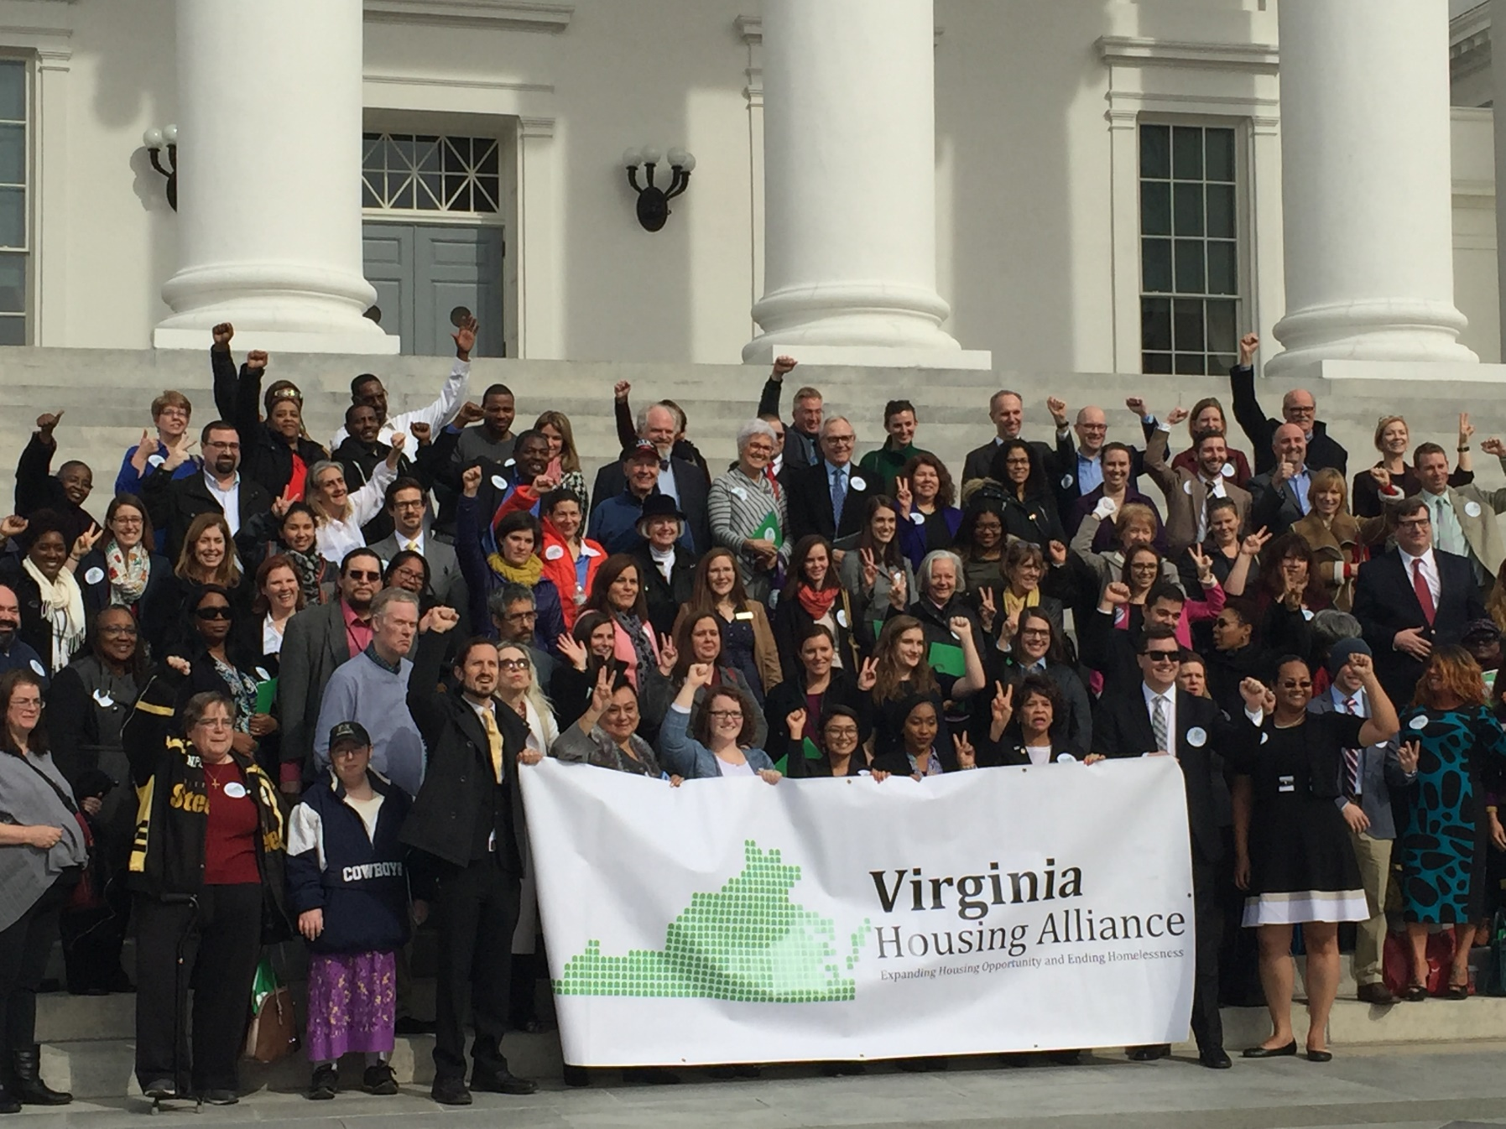
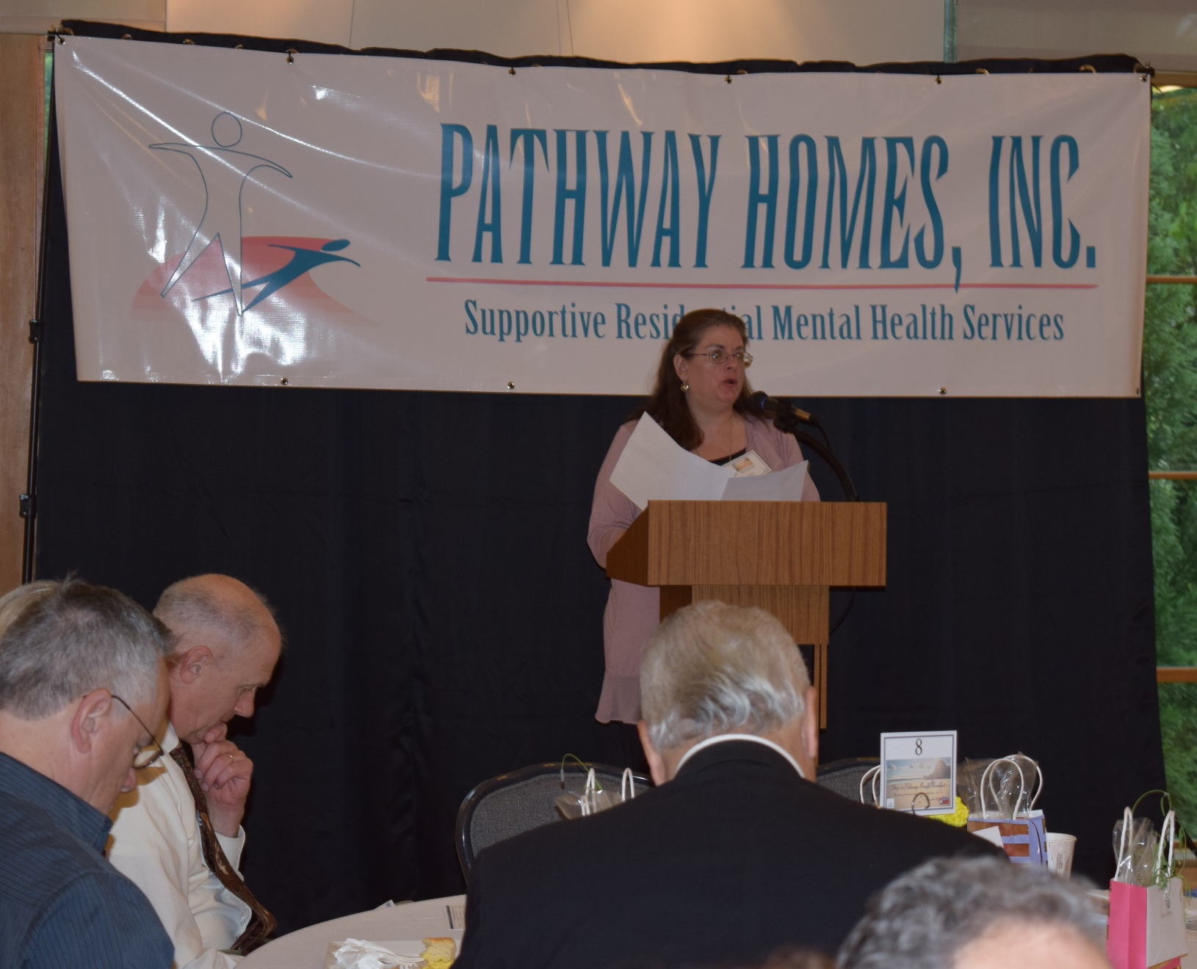
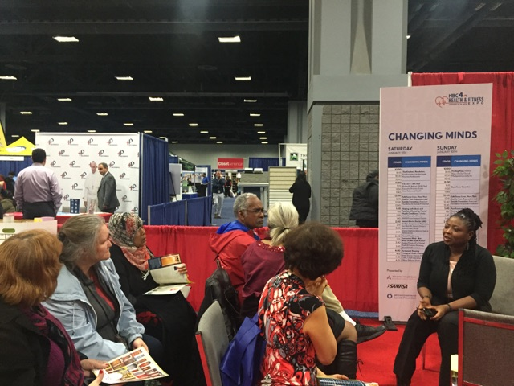
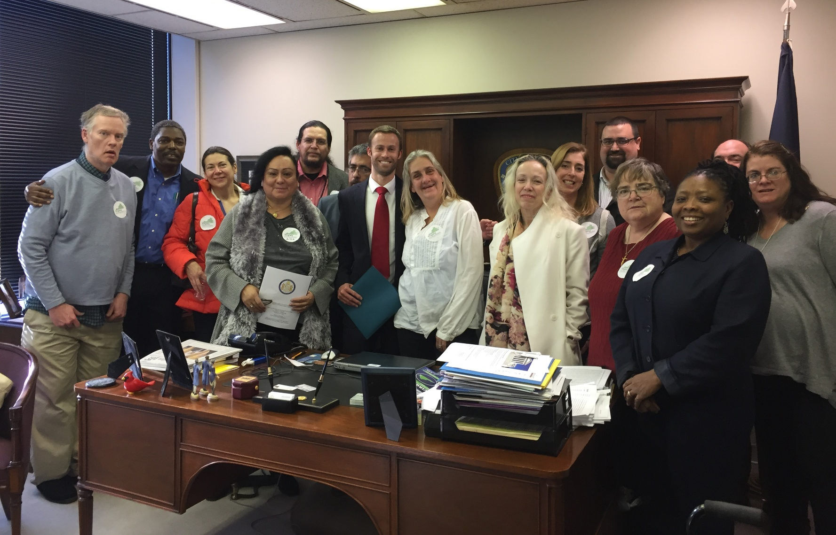
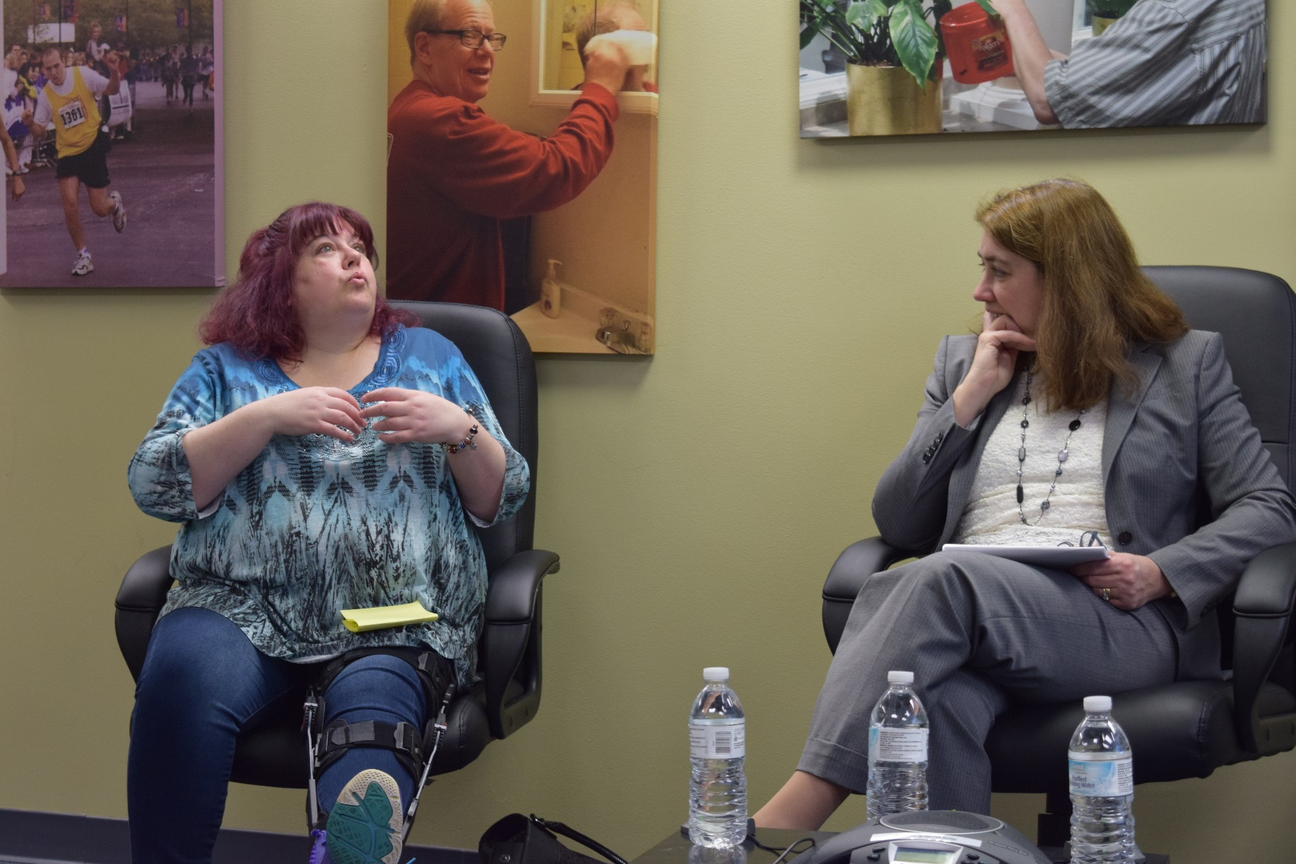
Advocacy Highlights
Notes:
NEED NEW PICTURES

Slide 26
FY2017 Advocacy Activities
Pathways Consumer Advisory Council (CAC) Housing Day trip to the General Assembly in Richmond
Pathways CAC Federal Housing Day trip to Capitol Hill in Washington D.C.
Presentation of Housing Needs White Paper to Fairfax CSB Board on behalf of Fairfax County Long Term Care Coordinating Council (LTCCC) and Concerned Fairfax
Pathways CAC videos for website
Steps to Pathways Seminars
Virginia Association of Community Based Providers (VACBP)- Transition to Managed Care
VACBP- QMHP Registration
VACBP- Injecting New Quality Measures in Behavioral Health Treatment

Slide 27
Agency Advocacy Priorities
Priority # 1
Proposed changes to eligibility criteria for mental health skills building will eliminate many individuals from qualifying for this service and impact Pathways’ ability to serve those in need of services.
Priority # 2
Private providers such as Pathways provide case management services but only CSBs can be reimbursed for these services in Virginia. Private providers can provide increased access at a lower cost.

Slide 28
Stable Housing
97% of individuals served remained in permanent stable housing.
Hospitalization (Medical)
90% were not hospitalized for medical reasons during the fiscal year.
Hospitalization (Psychiatric)
90% were not hospitalized for psychiatric reasons during the fiscal year.
Employment
18% of individuals were employed either full-time or part-time.
Veterans
4% of individuals served are United States Veterans.
Incarceration
<1% of individuals were incarcerated during the fiscal year.
Overall Satisfaction
92% of consumers report overall satisfaction with Pathway Homes’ services.
Notes:
UPDATED

Slide 29
Impact on Consumer Satisfaction 30% Response Rate
Satisfaction of Individuals Served:
82% Like the amount of time counselors spend with them
94% Believe Pathways staff treat them with dignity and respect
93% Believe the services they receive at Pathways improve their lives
92% overall satisfaction
Notes:
2017 = Decrease in all areas
30% response rate

Slide 30
Board Impact
Philanthropic contributions
All volunteer board
Range and depth of expertise
Board member recruitment and onboarding
Advocacy and education activities
Strategic Planning
Employee and Resident events
Leadership Team support

Slide 31
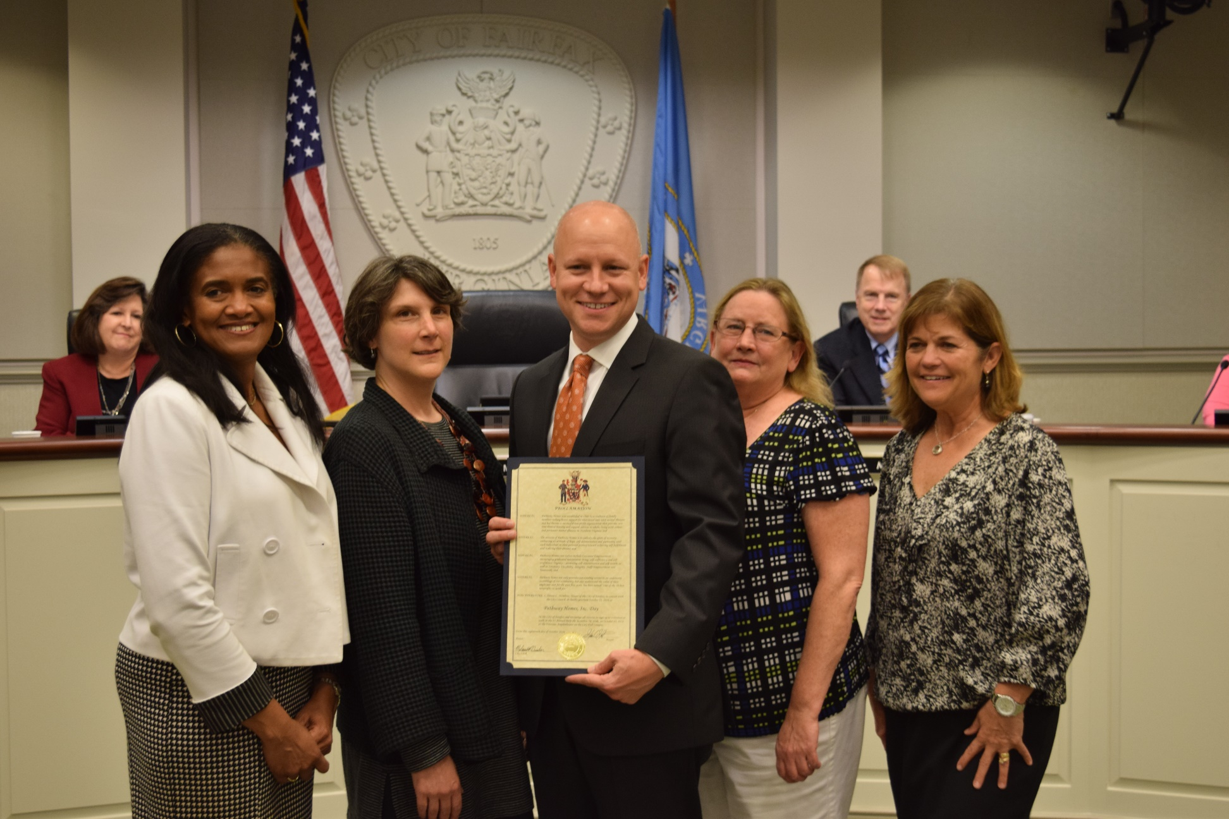
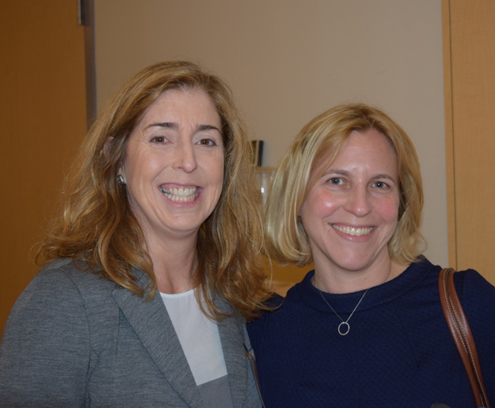
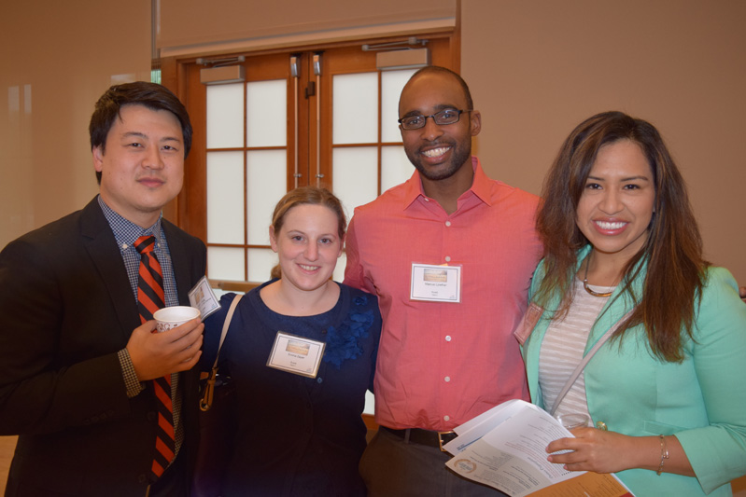
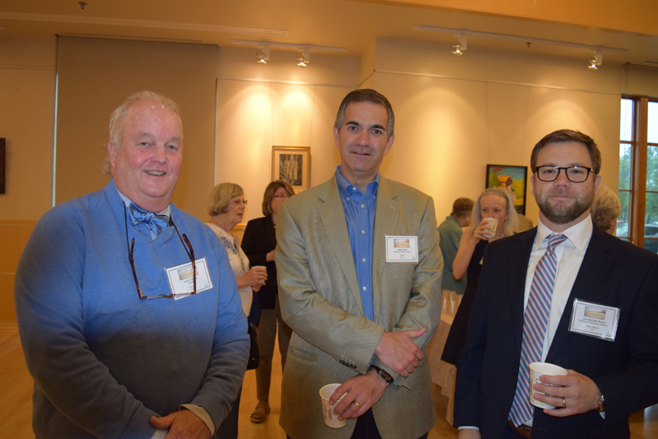
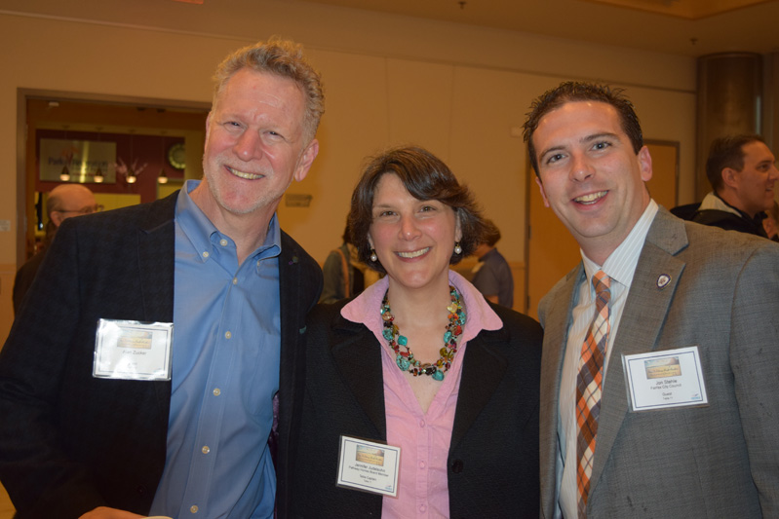
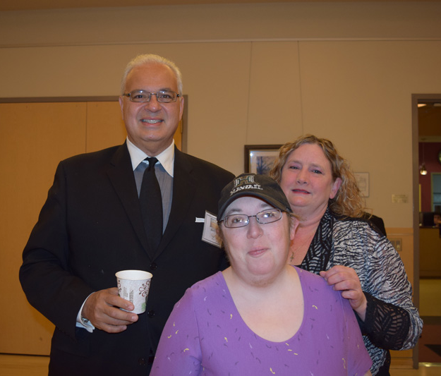
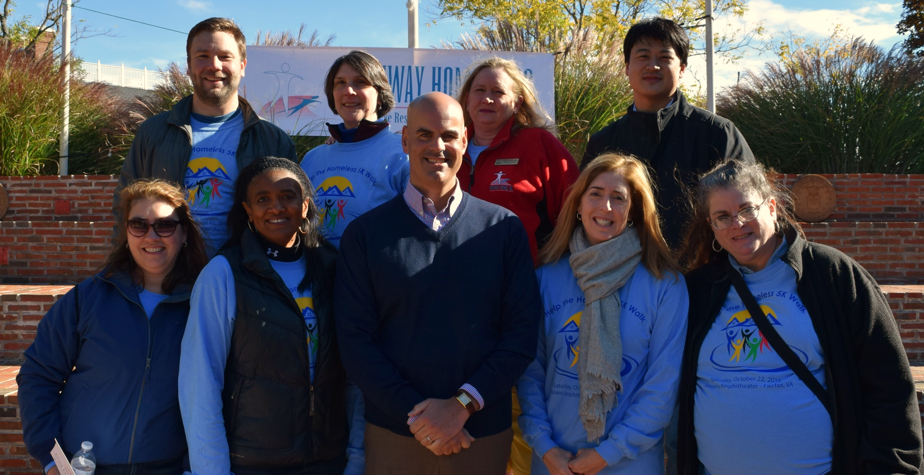
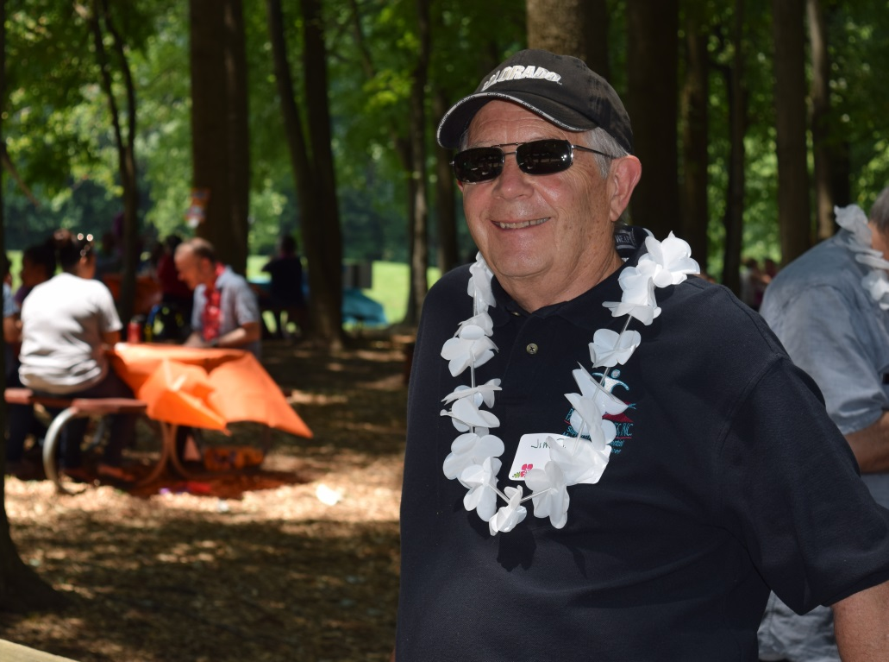
Pathways Board in Action
Notes:
UPDATED

Slide 32
Efficiencies
We are doing more with less – How?
Increased face-to-face requirements, Medicaid billing
Staff training
Technology
Outsourced support
Automated processes
Business processes
Software (EHR, Accounting, Property Mgt., HRIS)
Data collection and information management

Slide 33
2017 Best NonProfit Staff Survey
We made the list!
Award Sponsored by The Nonprofit Times and Best Companies Group
Nationwide survey – best places of employment in nonprofit industry
More than 10,000 employees surveyed
Must meet minimum threshold to make list
55 employees responded

Slide 35
2016-2021 Strategic Plan Goals
Adequately fund the work
Have sufficient number of skills and staff to do the work
Develop and use more efficient systems
Create a unified organization (communication)
Expand our ability to provide core services
Better move consumers through different levels of care
Position ourselves for new opportunities in core geographies
Build our brand in the state of VA

Slide 36
Strategic Goals Progress (10/3/2016 - 6/30/2017
1.1 Adequately fund the work
45 days cash on hand
Renewed Potomac Health Foundation grant for $125,000
1.2 Have sufficient number of skills and staff to do the work
Hired 1 RN and added 2 clinical certifications (NAADAC)
Management Team training in tenancy and landlord actions; opioid epidemic; and financial wellness
Expanded clinical internship program
Exploring expanded use of volunteers

Slide 37
Strategic Goals Progress (10/3/2016 - 6/30/2017
1.3 Develop and use more efficient systems
Office 365, SharePoint, and Yardi rollout
Implemented 80% of HR assessment recommendations
Revised housing workflow processes and reviewing other processes - staff training ongoing.
1.4 Create a unified organization
Staff updates at quarterly meetings
Building intranet using SharePoint
Use of shared calendars and IM

Slide 38
Strategic Goals Progress (10/3/2016 - 6/30/2017
2.1 Expand ability to provide core services
97% remain housed
74% are engaged in productive daily activity
100% are connected to health care as needed
2.2 Move consumers thru levels of care
Added 55 new beds thru housing grants and subsidies
Increased # of staff who are SOAR-trained
RN hired
Notes:
NEED FY17 OUTCOMES
SOAR = SSI/SSDI Outreach Action and Recovery

Slide 39
Strategic Goals Progress (10/3/2016 - 6/30/2017
2.3 Position re: new opportunities in core geographies
Increased # served in Fairfax by 29
Obtained funding for 10 more PW CSB beds
Increased # served in central FL by 107!
Developed separate BOD
Developed strategic plan
Notes:
2015 SHP = 22
DHCD Acquisitions = 7

Slide 40
Strategic Goals Progress (10/3/2016 - 6/30/2017
3.1 Build our brand in the state of VA
Website updates ongoing with QA/IT support
Defined and communicated agency advocacy priorities
Active engagement of CAC in local, state, and national advocacy events

Slide 41
Looking Ahead
Property Management software and SharePoint implementation completion
HRIS software rollout
New service lines: Geropsychiatry, Outpatient, Crisis Stabilization, Medicaid ID Support Services, Behavioral Health Homes, Veterans Services, Loudoun County, Housing Development, Supported Employment
Co-occurring staff competency training
Increased fundraising
Consumer Advisory Board advocacy
Notes:
even the best laid plans have a certain level of uncertainty since we can’t fully know what the future holds…but we are NIMBLE and ADAPTABLE!

