Slide 1
FY 2014
State of the Agency
Presented to the Board October 6, 2014

Slide 2
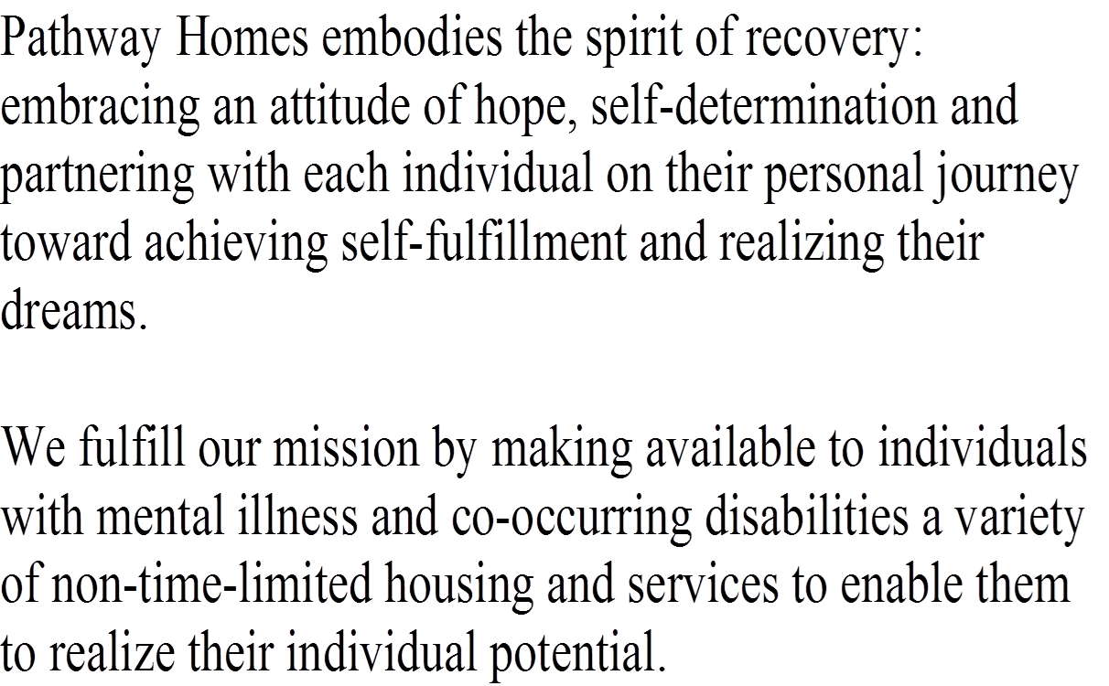
Mission Statement

Slide 3
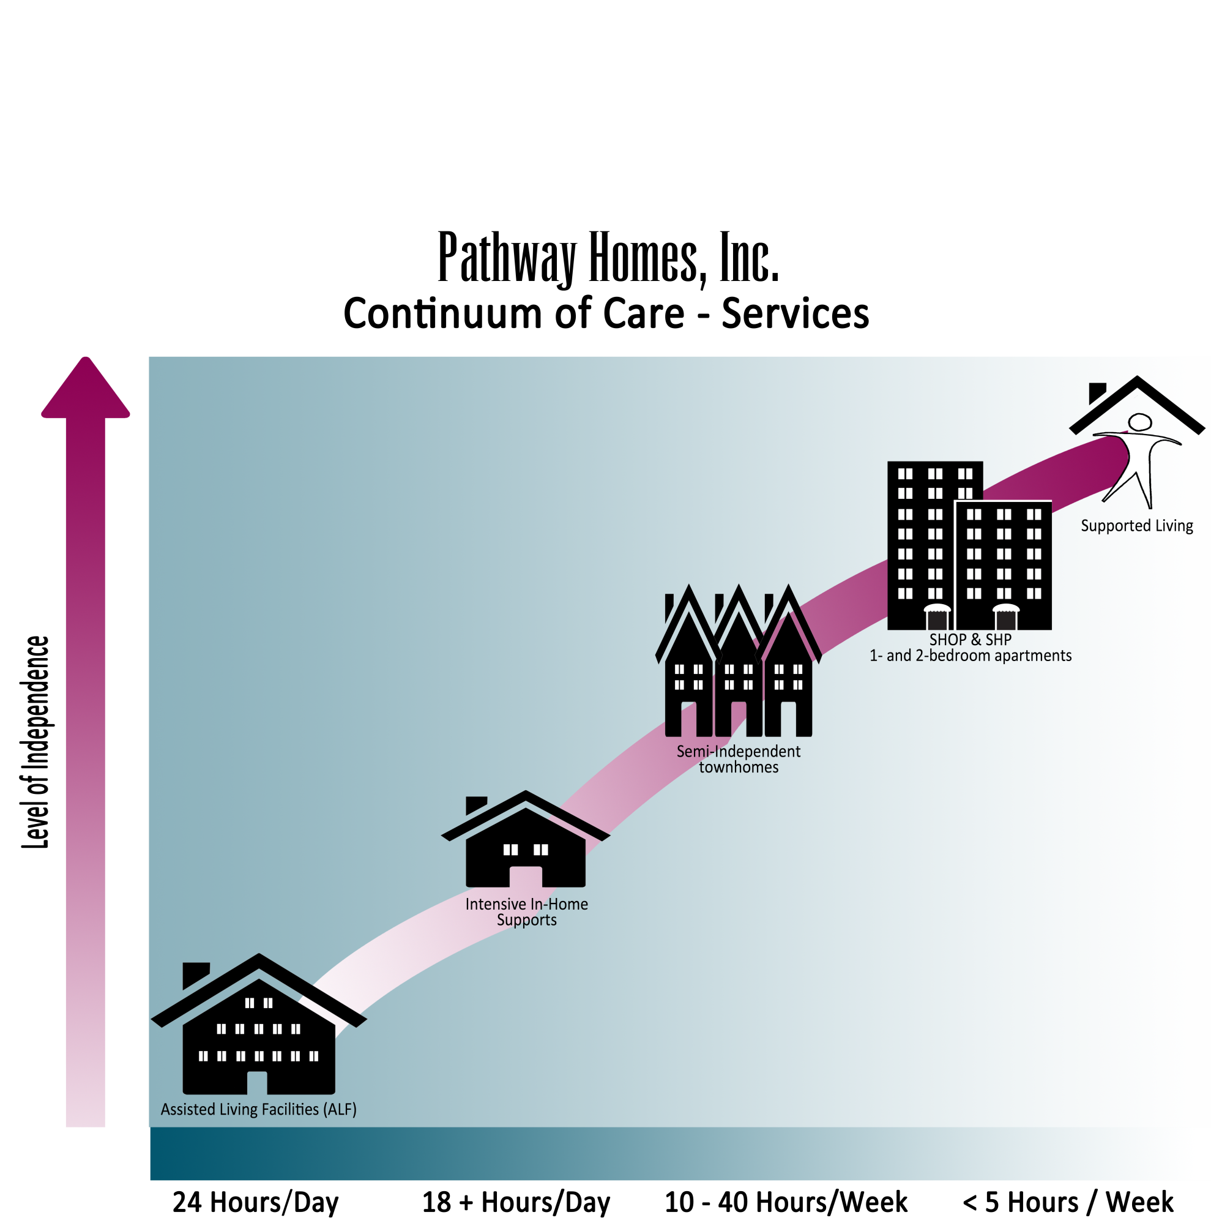
Notes:
Continnuum of Care - Services

Slide 4
Recovery
Client Services and Healthcare
Acquisition and Development
Education and Advocacy
Notes:
Paths to Recovery

Slide 5
Housing Inventory
Pathway Homes manages more than 200 properties

Slide 6
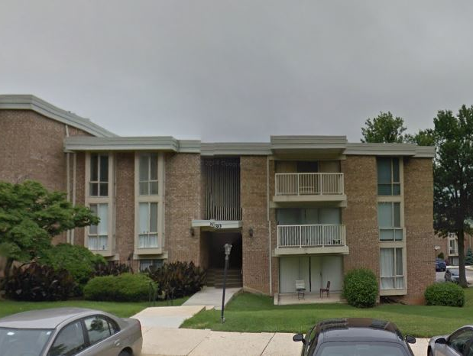
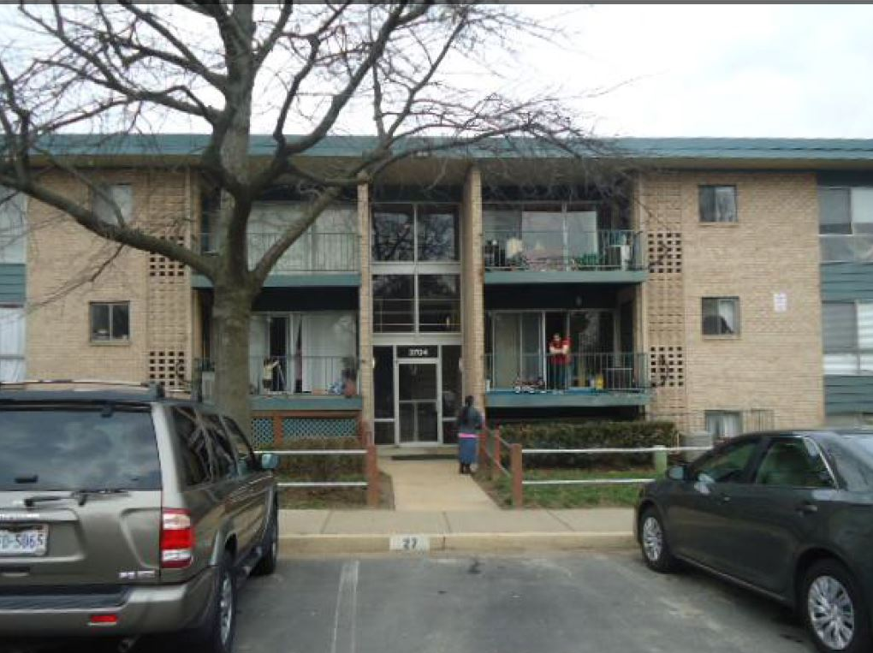
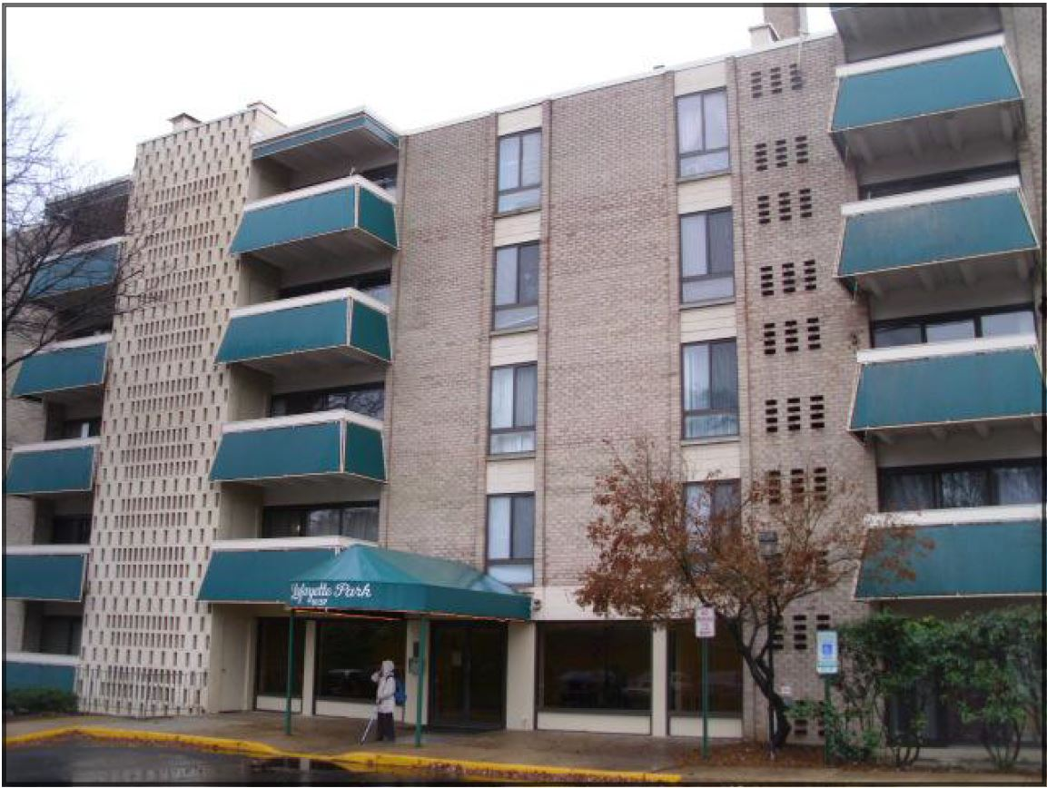
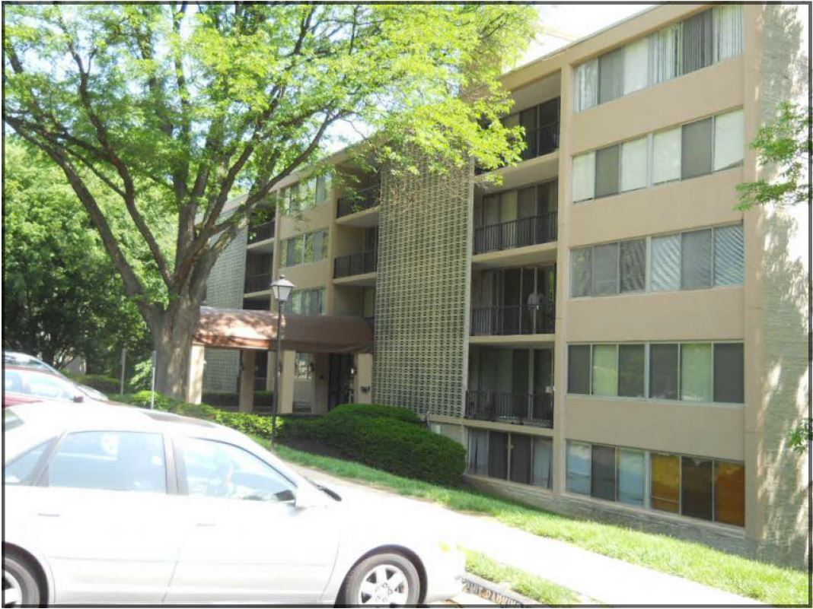
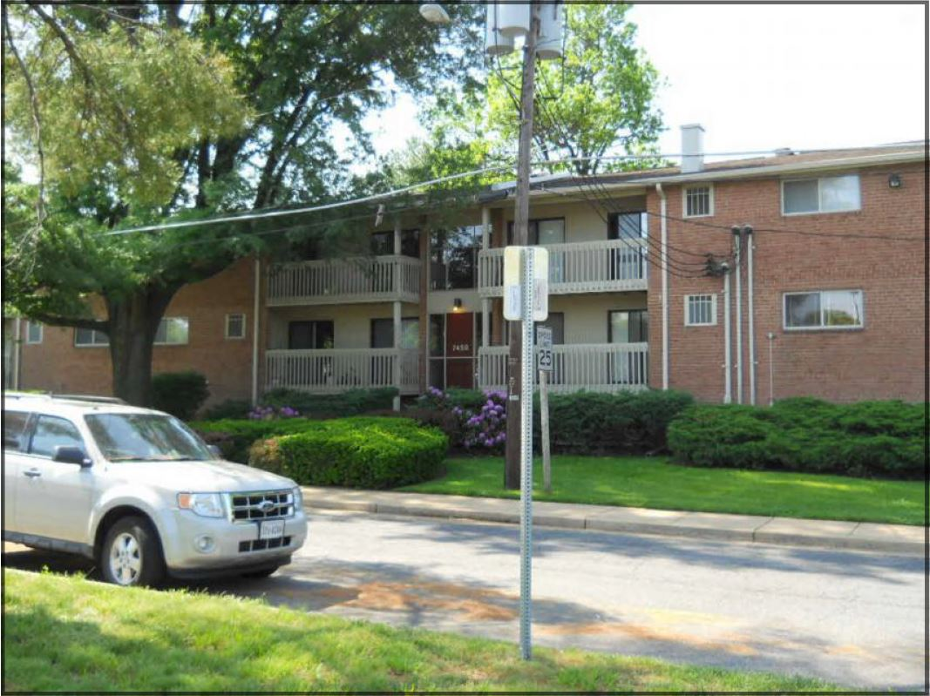
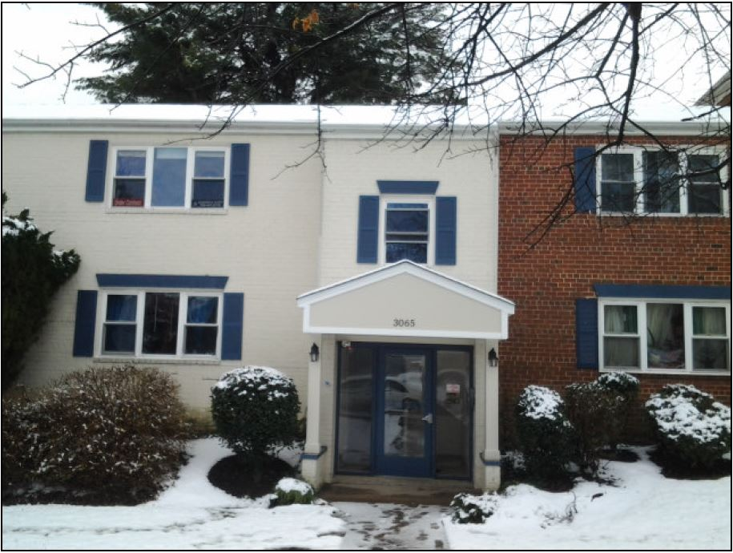
Who Do We Serve?
Notes:
New Home photos – Wagon, Leesburg Pike, -pull the white page to the front

Slide 7
438 Served
Notes:
Numbers served – please count individuals in the originating Pathways program so the total served remains at 438 and is consistent with what we have elsewhere – thanks!

Slide 8
Consumer Satisfaction
359 surveyed in June, 2014 – 35% response rate.
  *96% feel counselors respect their cultural, ethnic, and life choices.
  **94% are satisfied with Pathways’ services.
  94% feel their counselor is helpful to them.
  84% like the amount of time their counselor spends with them.
  ***91% feel supported in exploring all potential housing options.
  *Highest overall rating 2 years in a row
  **In top 5 highest rated response past 4 consecutive years
  ***Added by Consumer Advisory Council in 2012

Slide 9
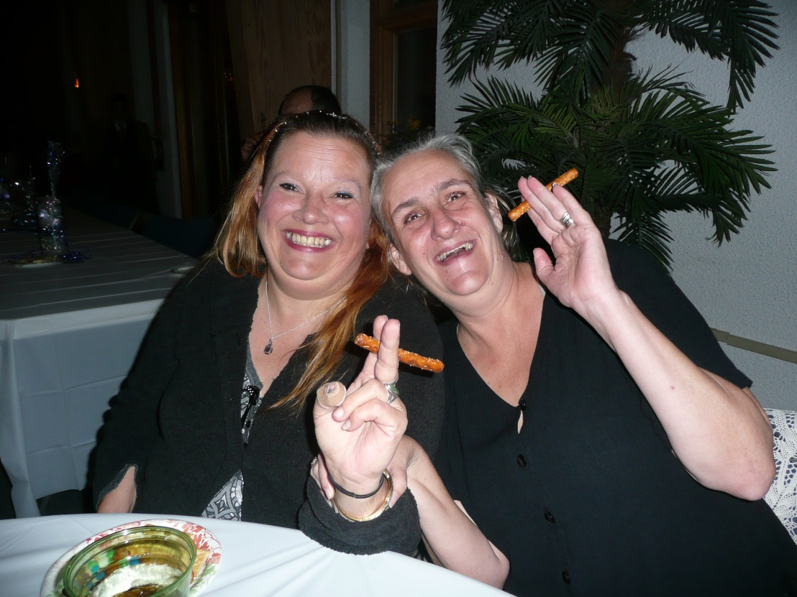
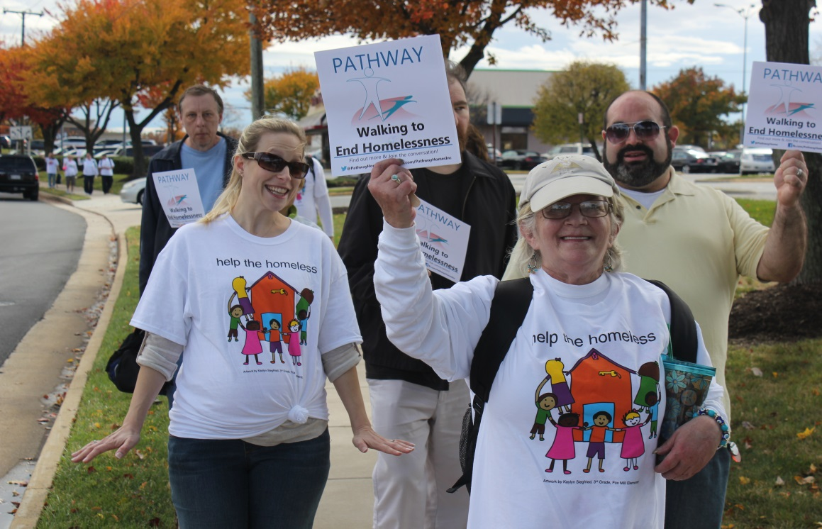
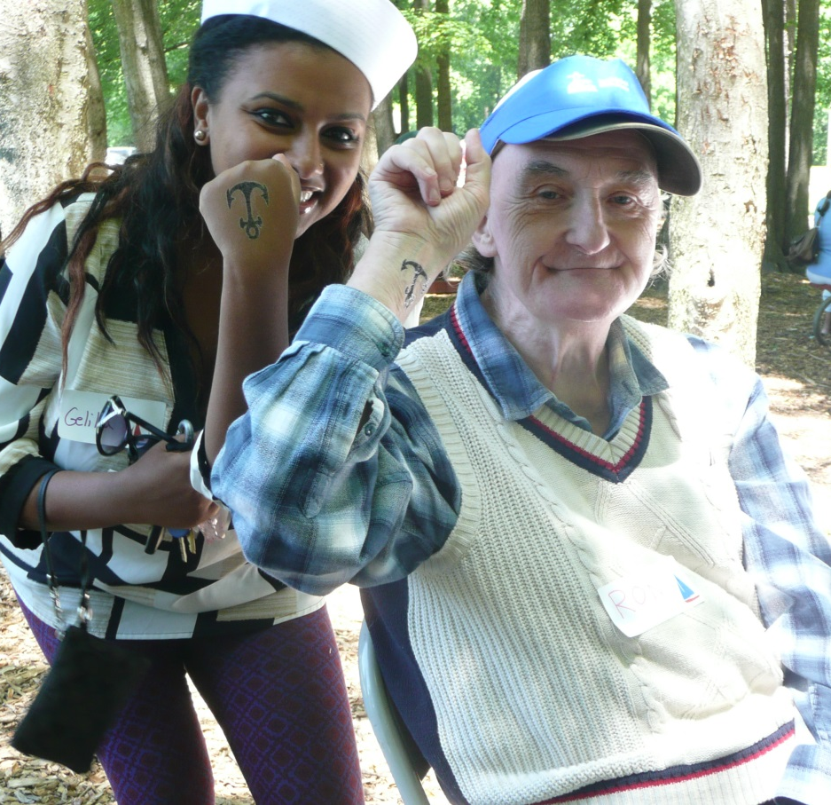
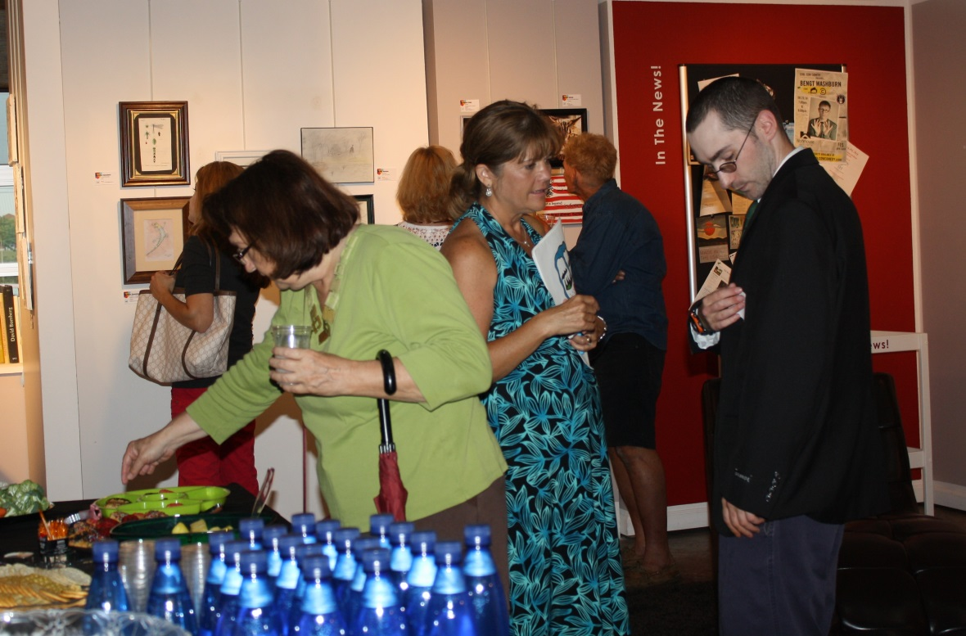
Notes:
CHANGE THESE PICTURES – resident holiday party, cookout, summer of the arts, help the homeless 2013

Slide 10
592 on Waiting List in FY14
Notes:
Waiting list differences between FY13 and end June 2012. Increase in most areas. Waitlist in 2012 was

Slide 11
Homeless History
61%
39%
51%
49%
*Male includes 1 individual identifying as transgender female to male

Slide 12
Axis I Diagnoses of Individuals Served
N=396
Note: the data on this chart is not presented as % as some individuals are duplicated across diagnoses.

Slide 13
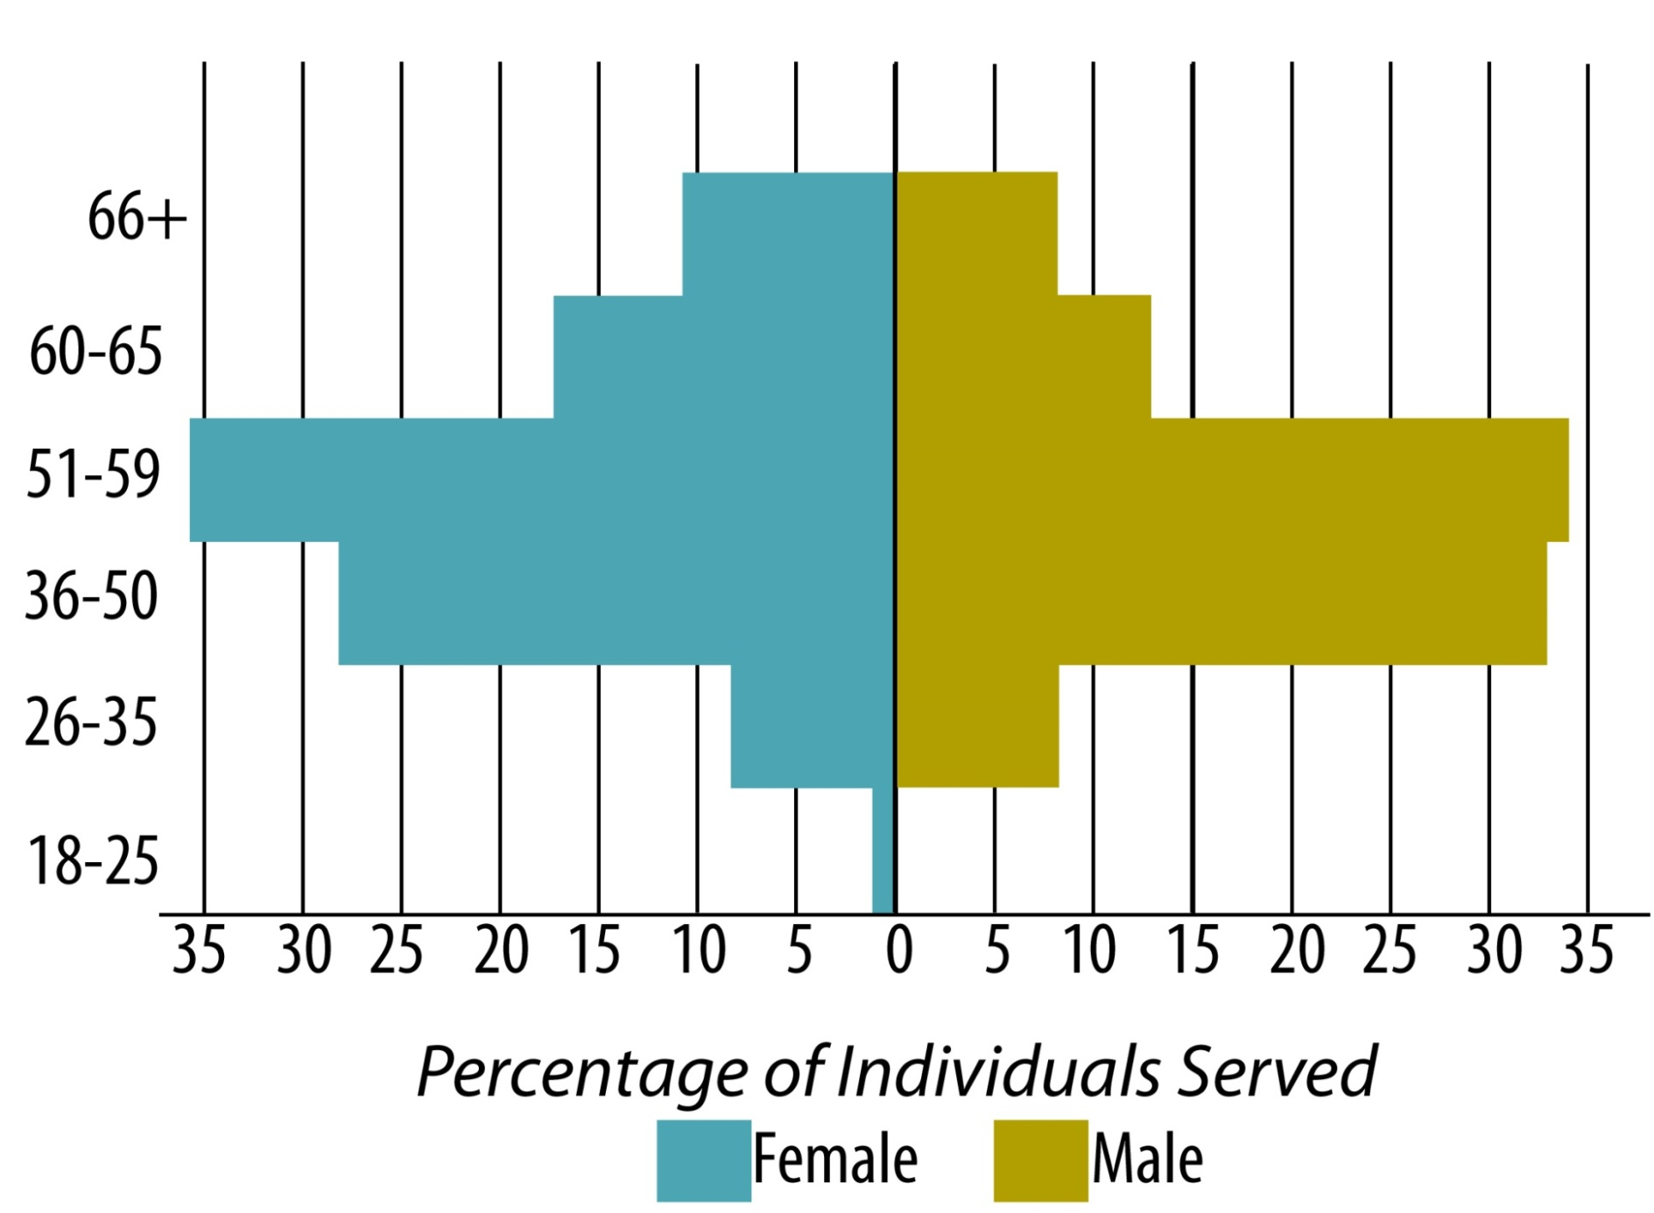
Age Range
Average Age is 52

Slide 14
Age (51 and Older)

Slide 15
Age (66 and Older)

Slide 17
Veteran Status

Slide 18
Employment Status

Slide 19
Organizational Scan
Strengths
Highly skilled staff
Best practice and innovative models of care (Housing First, DBT, MI, Peer Support, etc.)
Community partnerships.
Fiscal management.
Stakeholder involvement.
Program development and implementation.
Acquisition & Development
Education & Advocacy
Weaknesses
Highly specialized clinical base – need more training in co-occurring disorders.
Limited opportunities for upward mobility of staff.
Baseline funding
Notes:
Education and Advocacy: Help the Homeless; Fair Housing; State Advocacy (Richmond)

Slide 20
Organizational Scan
Opportunities
Threats
Medicaid
Fairfax, Prince William, Loudoun County CSBs, Washington DC, Central FL
Volunteers
Information Technology
Philanthropic outreach
Public education and advocacy
Increase in licensed staff
Potential Medicaid and county budget cuts
Aging consumers and staff
Salary disparity

Slide 21
Strategic Goals
Increase housing stock and recovery-based services.
Maintain competent, qualified and satisfied workforce.
Market Pathway Homes as a best practice organization and develop supportive partnerships.
Ensure financial health and long-term viability of the organization.

Slide 22
Strategic Plan Objectives
Information Technology
Recovery
Growth
Human Resources
Communication

Slide 23

Information Technology
Transition to secure electronic health records.
Upgrade systems to improve communication.
Maintain hardware/repair computers timely.
Upgrade agency hardware/transition to laptops as appropriate.
Upgrade accounting software (Abila formerly Sage)
Implement Telework policy
Initial and ongoing training on IT security.
Develop email list for newsletters/solicitations
Conversion to VOIP telephone system.
Update agency website

Slide 24
Recovery
Continue to develop consumer-directed housing programs in community.
Create/expand volunteer positions in the agency that integrate consumers.
Create opportunities to support the “good life” for consumers.
Engage in community projects/activities to reduce stigma
Maintain Recovery Committee to implement recovery training to all stakeholders.

Slide 25
Growth
Enhance clinical skill base re: co-occurring multiple disabilities.
Develop programs that allow for step-down opportunities for current residents.
Sponsor new consumer-directed programs/restructure existing programs.
Expand public/private partnerships to develop new housing and supports.
Provide housing and/or support services to a total of 425 by 2016.

Slide 26
Growth cont’d
Maintain active involvement with OPEH.
Expand corporate, community, and county partnerships.
Increase agency personnel infrastructure as needed to adjust to changing needs.
Develop and implement a major IT fundraising campaign.

Slide 27
Human Resources
Form task force re: improving recruitment and hiring practices.
Expand opportunities for internal training for staff and management to include CEUs.
Shrink increased gap between comparable agency and county positions where possible.
Further senior level talent management and leadership development/succession planning.
Expand opportunities for agency program networking and team building.
Hire Major Gifts specialist philanthropy position.
Develop and implement Telework policy.

Slide 28
Communication
Educate staff about all agency programs and services.
Utilize IT improvements to streamline communication among staff.
Develop stakeholder email list.
Convert agency newsletter to electronic format.
Explore development of VOIP to allow direct dialing to staff extensions.
Explore development of agency video for You Tube or other media use.
Update agency website to increase attraction and ease of use.

Slide 29
Financials
SUPPORT AND REVENUE
Government Grants and Contracts $8,510,332
Fees and Rents 1,256,611
Contributions 145,410
Sublease and Other Income 73,079
Interest and Dividends 7,374
Total Support and Revenue $9,992,806
EXPENSES
Program Services
24 Hour Residential Facilities $2,551,665
Supported Residential Facilities 4,864,505
Total Program Services $7,416,170
Management and General $1,834,903
Fund-raising and Development 17,639
Total Expenses $9,268,712
Change in net assets $ 727,697
Net Assets at the Beginning of the Year 6,995,301
Net Assets at the End of the Year $7,722,998

Slide 30
Support and Revenue
Notes:
Contributions: $160, 220
Direct fundraising
Grants
Expenses
- Cost of mailing

Slide 31
Expenses

Slide 32
Fundraising
94% increase in # of new gifts overall
28% increase in individual donations ($53,369 to $68,523)
30% decrease in organizational funding ($106,743 to $75,598)
9% decrease in total contributions
$176, 542 to $145, 320
$28,000 in new corporate funding (Capital One, Bank of America, and Maximus Foundation)

Slide 33
Human Resources
115 staff during FY 2014
21 employees left; 12 completed exit interview
Reasons for leaving:
  Professional growth: 6 (5 moved into CSB jobs)
  More pay: 6
  Relocation: 2
  Other: 2 (Contract ending; Job requirements)
25 new employees started
3,912 volunteer hours
Total value of volunteer hours = $95,080
Note: some individuals provided more than one reason for leaving

Slide 34
Employee Satisfaction
  November 2013: Nonprofit Times 50 Best Nonprofits to Work for in the US
    More than 10,000 employees surveyed across the US
    Small to large-sized non profits (Pathways – medium: 50-249 employees)
    45% response rate for Pathway Homes
    81-question survey
      25% organization overall
      75% employee engagement and satisfaction – workplaces experience and organizational culture (76 questions)
Pathways ranking: 14th (2014); 28th (2013); 47th (2012)

Slide 35
Employee Satisfaction
Benchmark Report
Pathway Homes
Other Similar-Sized Non Profit
  94% Role Satisfaction
  92% Work Environment
  95% Relationship with Supervisor
  93% Leadership and Planning
  92% Corporate Culture and Communication
  84% Training, Development and Resources
  80% Pay and Benefits
  90% Overall Employee Engagement
  91% Role Satisfaction
  90% Work Environment
  91% Relationship with Supervisor
  89% Leadership and Planning
  88% Corporate Culture and Communication
  81% Training, Development and Resources
  87% Pay and Benefits
  89% Overall Employee Engagement

Slide 36
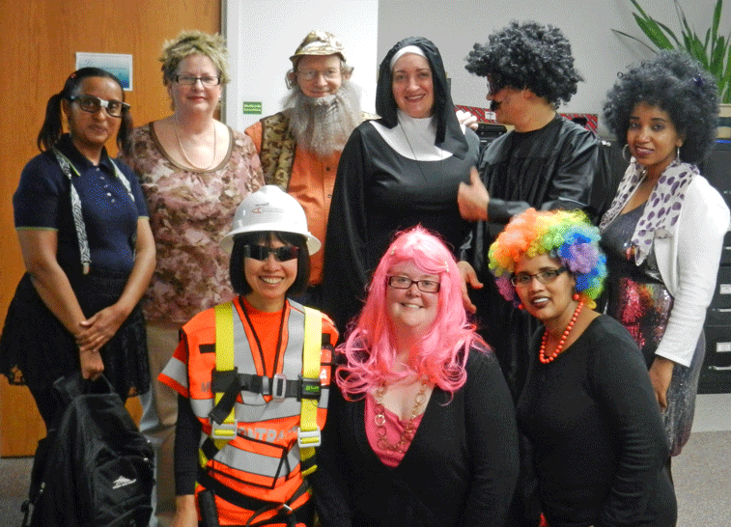
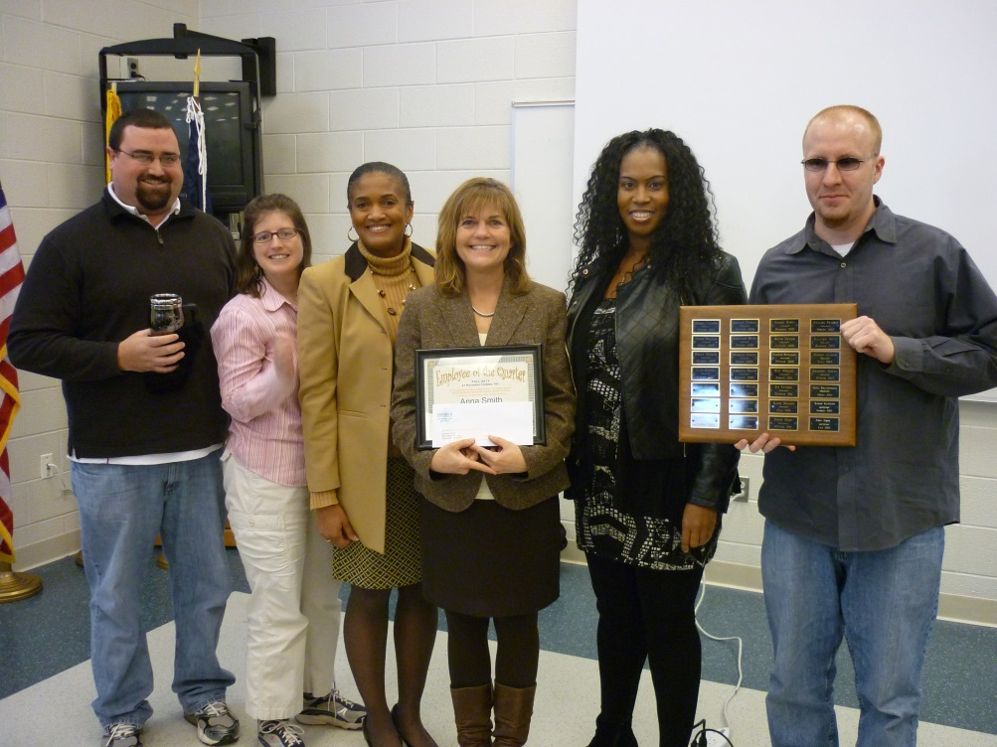
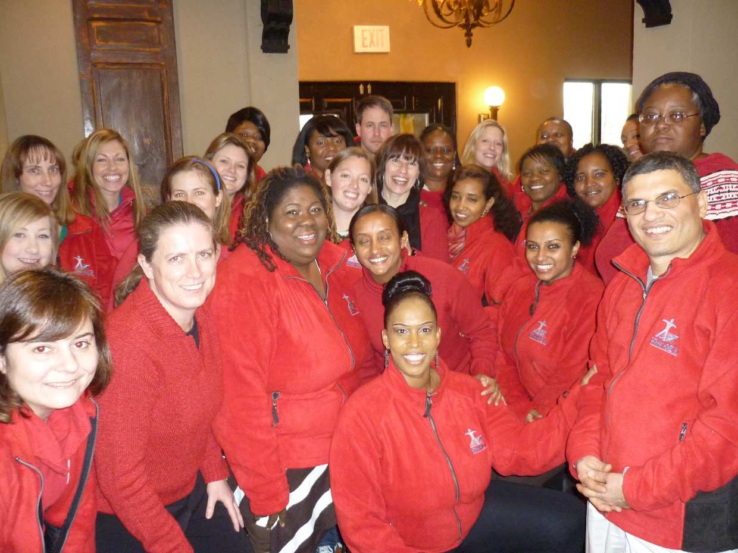
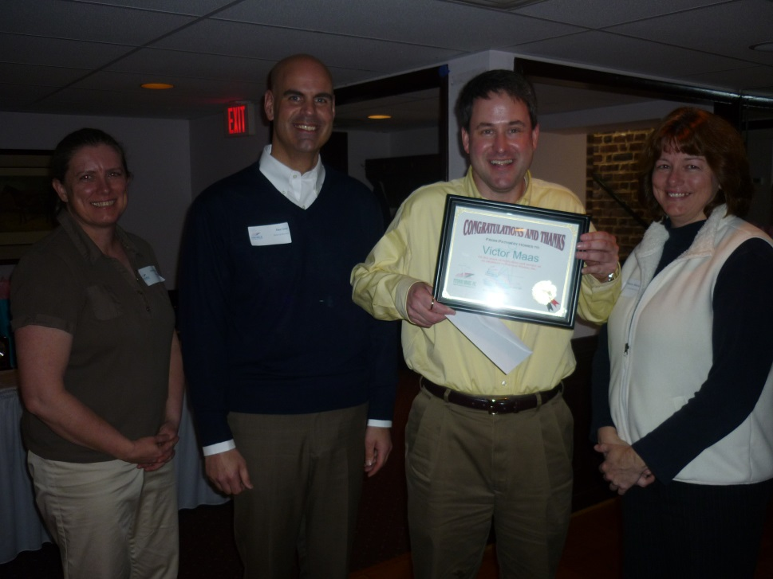
Notes:
Staff having fun

Slide 37
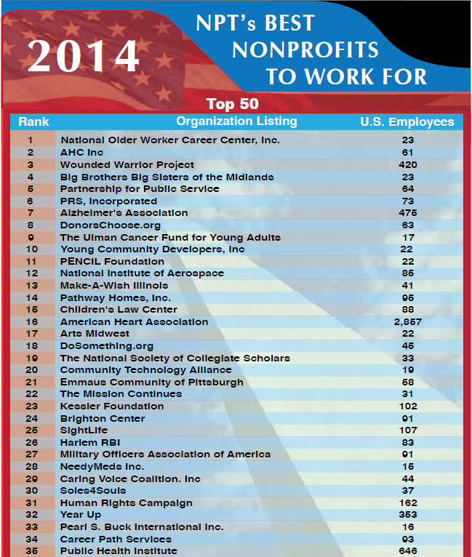

Pathway Homes was ranked 14th overall, and 6th for Medium Organizations, employing between 50 and 249 individuals.
Notes:
Best Non-Profit to Work for in 2014 - CHANGE

Slide 38
FY 2014 Efficiencies
$12, 454 FY13 to FY14: decreased use of IT Consultant. More than $20,000 saved over 3 years!
$3,750/yr: Smartphone hotspot connection for clinical staff using Credible in the field.
$180/yr: Re-negotiation of AT&T contract + HIPAA-compliant cloud-based BOX for 10 users
Across the board 10% discount negotiated in Credible contract renewal used towards adding new users. Also 1% discount in annual fee increases over 7-yr contract.
Ability to track face-to-face time leading to concrete targets and increased productivity – current average 55%.
VOIP is saving staff time and increasing efficiency.
$37,776 saved in HUD refinance
Notes:
SAGE
- Creation of special EXCEL worksheets is now minimized resulting in increased accuracy and accountability of information coming from original source instead of a secondary source document.

Slide 39
Education and Advocacy
Staff elected as Vice Chair for the Virginia Community-Based Providers (VACBP) group
Monthly Steps to Pathways Seminars
Staff appointed by Fairfax Board of Supervisors to Fairfax Long Term Care Coordinating Committee
Annual Help the Homeless Community Walks/Education
Fair Housing Advocacy
Annual Summer of the Arts Exhibition
Ongoing anti-stigma efforts through presentations, articles, and social media

Slide 40


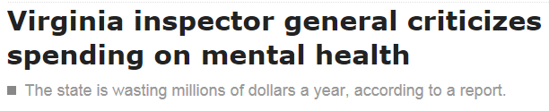


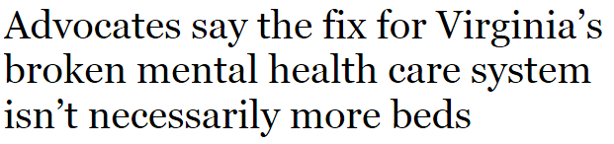
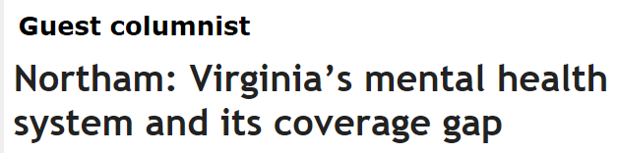
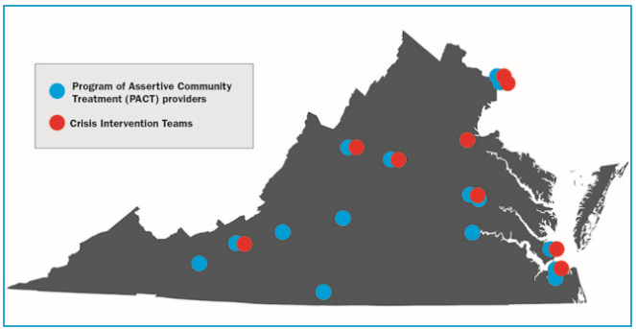



Notes:
VACBP – no cuts in MHSS funding; Creigh Deeds; Jennifer picture?; Navy Yard incident?, VA Tech incident, homelessness?

Slide 41
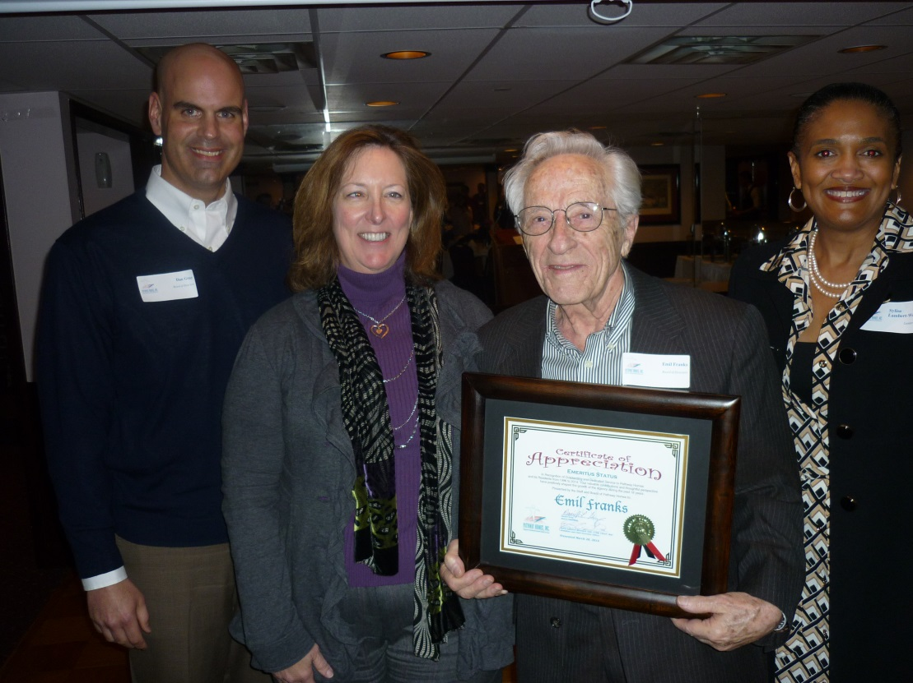
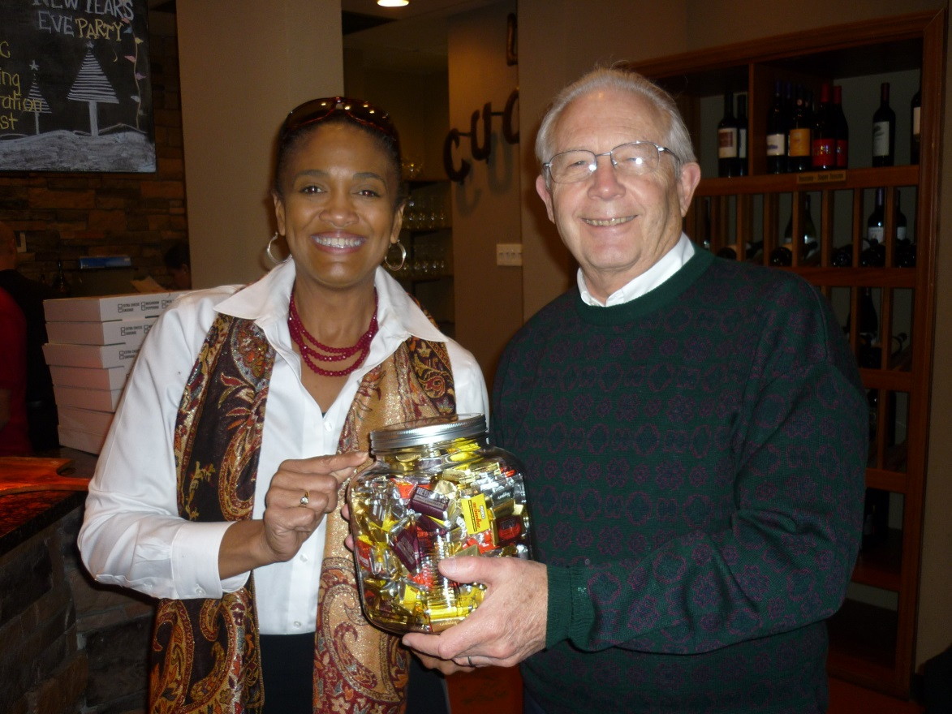
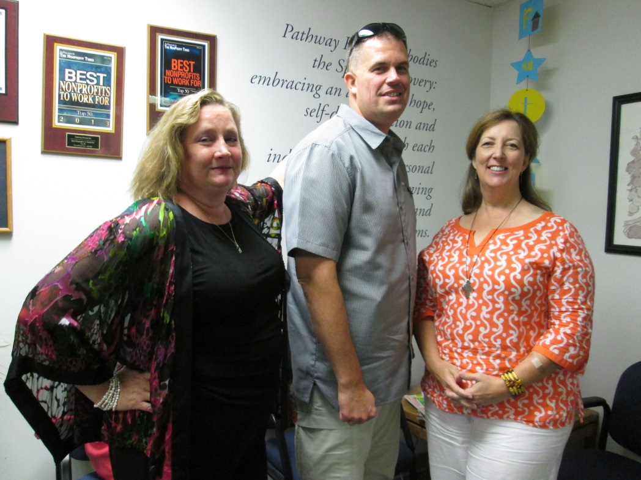
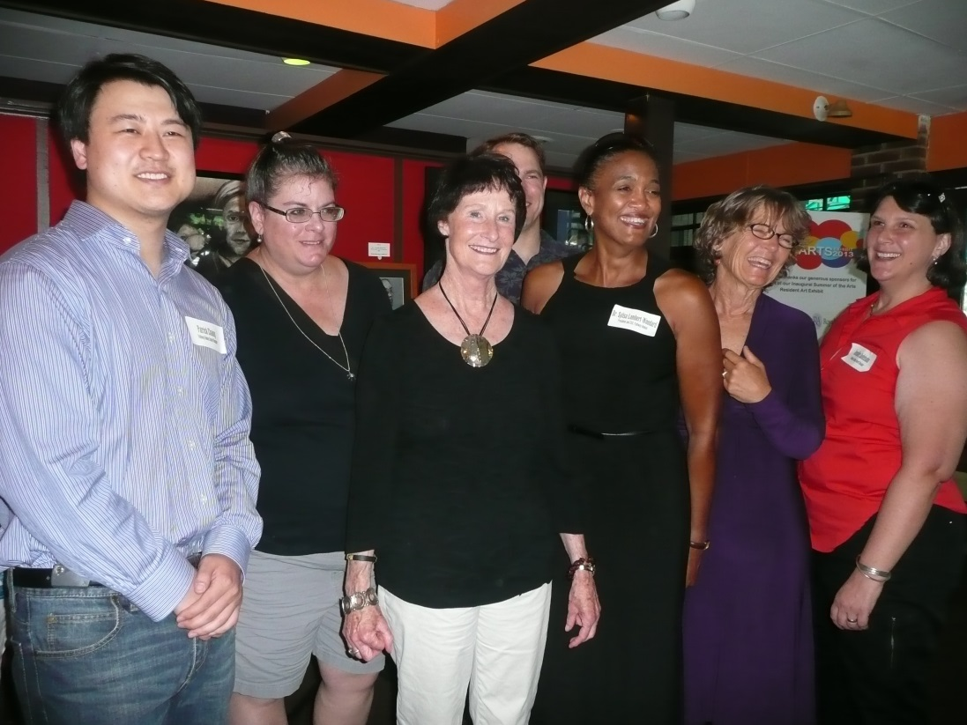
Notes:
Pictures of the Board

Slide 42
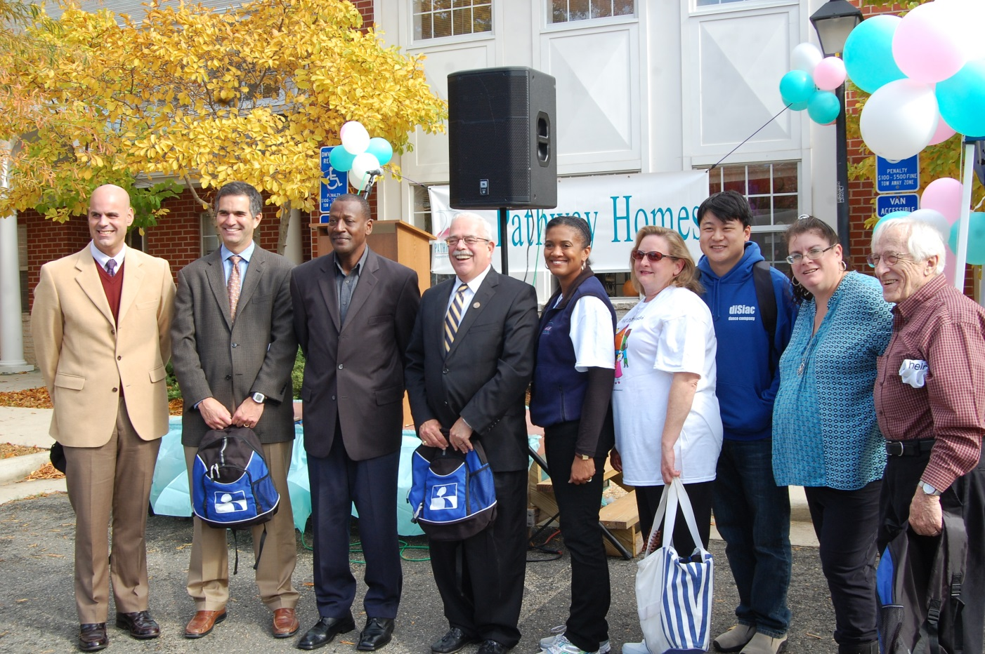
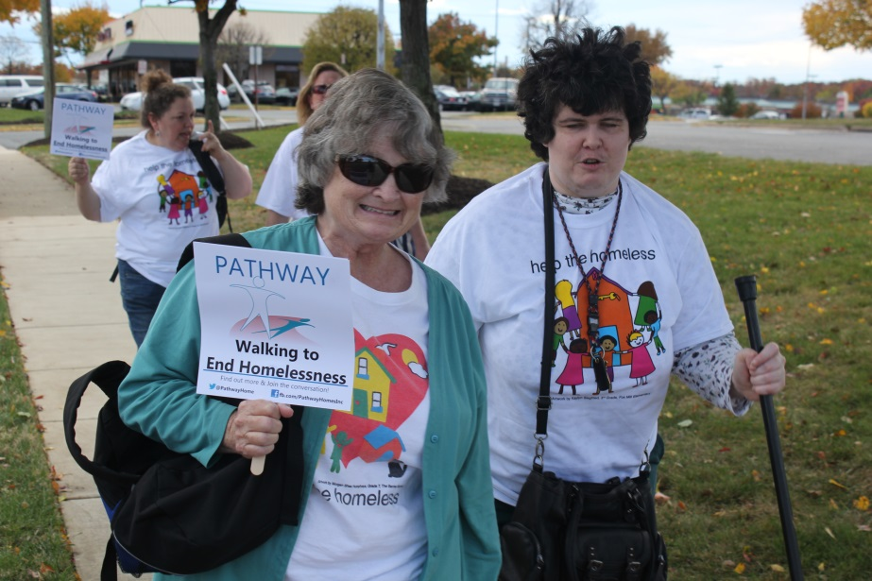
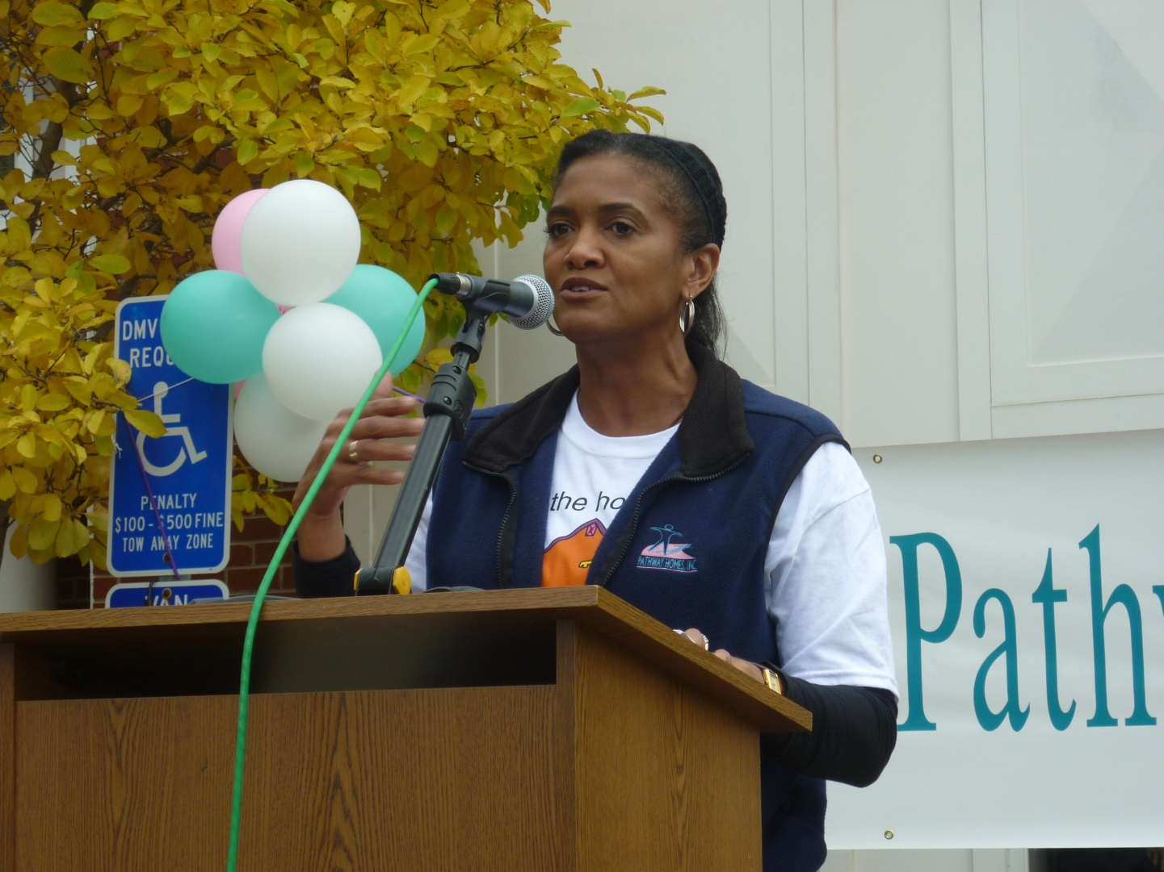
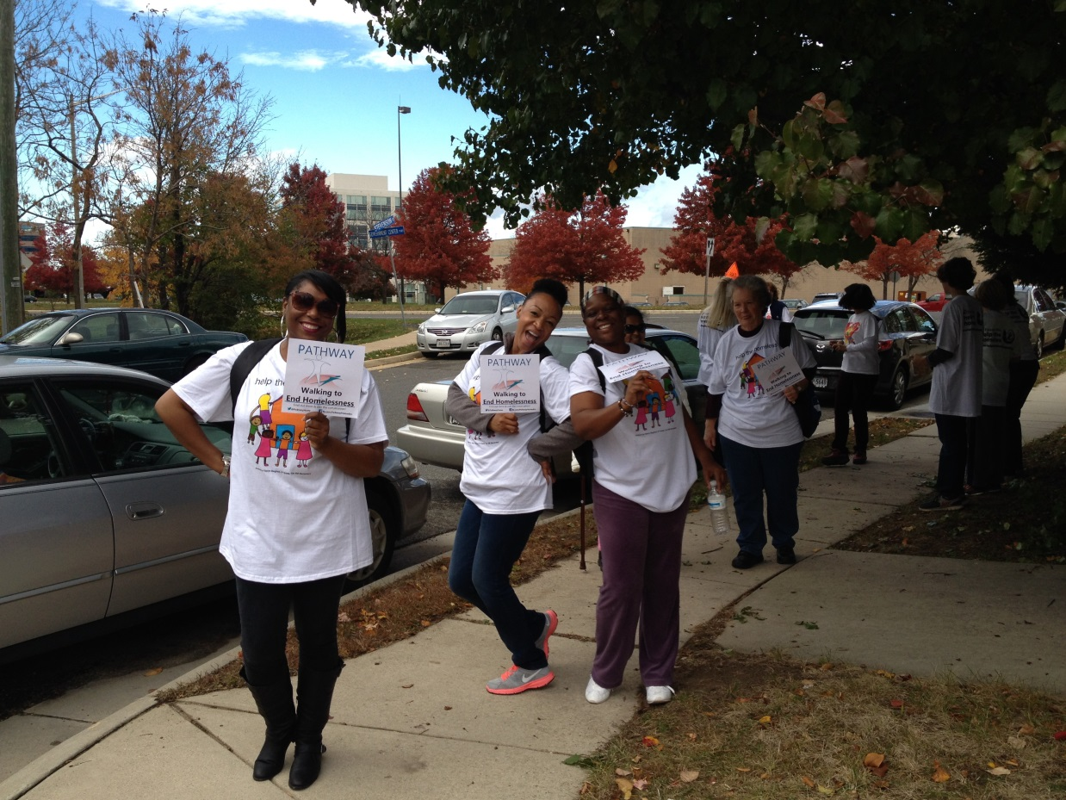
Notes:
Help the Homeless 2013

Slide 43
Year End Highlights
Finalist for the Helios Apollo Awards
Ranked 14t^{h} on The NonProfit Times 50 Best Nonprofits to Work For 2014 list.
Expanded programming into Prince William County – 1st ALF for individuals with mental health disabilities.
Provided consultation to the county on ALF design and programming.

Slide 44
Year End Highlights
Added 6 new homes to Pathways housing stock.
Received approx $4.2 million in county and federal awards and renewals.
Awarded staffing contract with Fairfax County CSB.
Received satisfied judgment in Fair Housing lawsuit.

Slide 45

Looking Ahead
Service & Health Care:
  Reduce waitlist
  Extend services regionally/nationally
  Ensure evidence-based service delivery
  Acquisition
  Ensure maintenance of existing properties
  Secure and operate 57-bed Lorton property

Slide 46
Looking Ahead
Education & Advocacy:
  Local, State, and internationally.
  Ongoing presentations, articles, and speaking engagements.
  Ongoing anti-stigma campaigns.

Slide 47

Thank You…
Looking forward to the year ahead!

