Slide 1
FY 2015
State of the Agency
Presented to the Board October 12, 2015

Slide 2
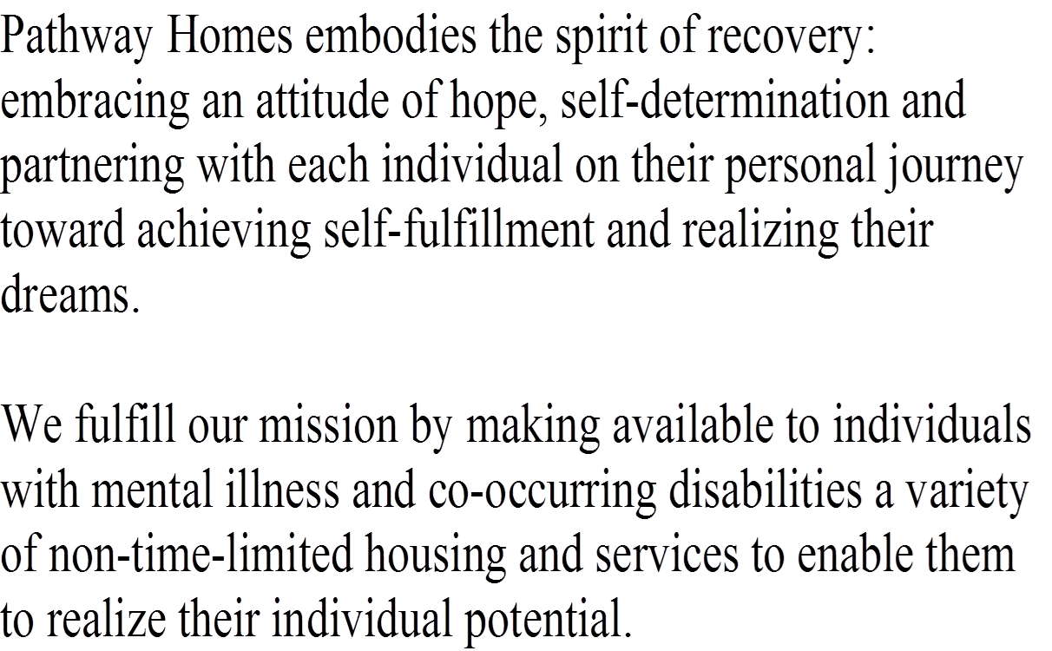
Mission Statement

Slide 3
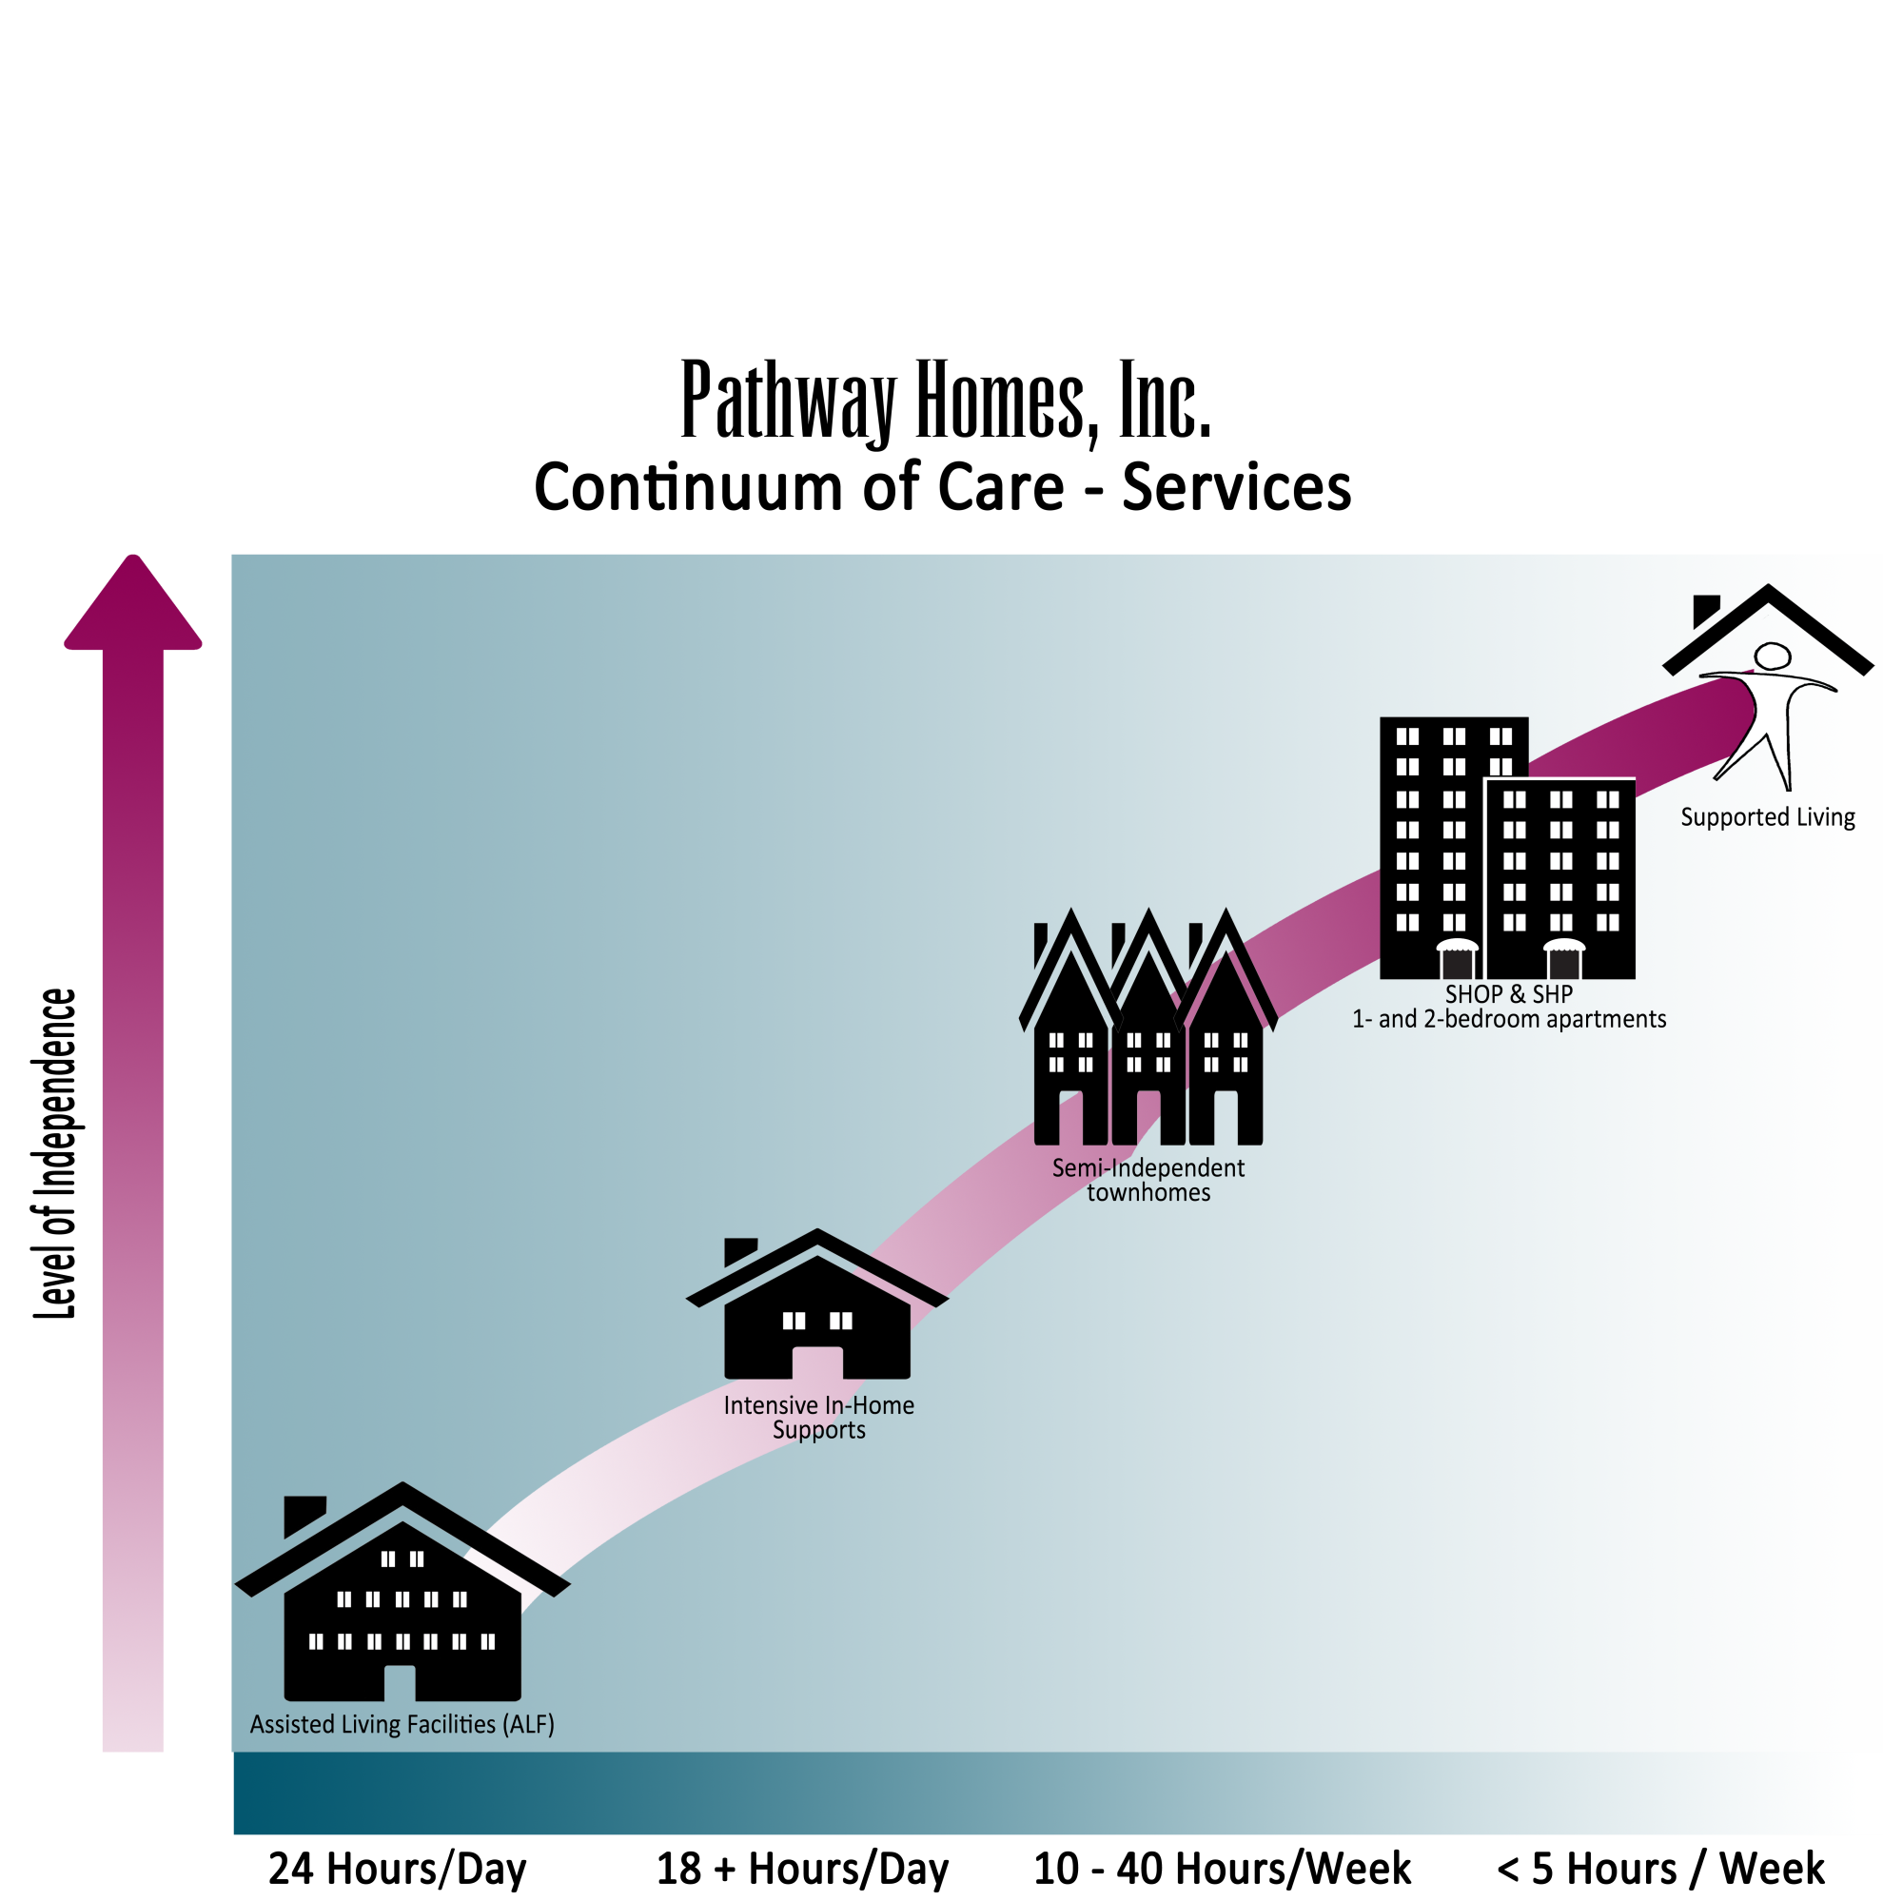
Notes:
Continnuum of Care - Services

Slide 4
Recovery
Client Services and Healthcare
Acquisition and Development
Education and Advocacy
Notes:
Paths to Recovery

Slide 5
Housing Inventory
Pathway Homes manages more than 200 properties

Slide 6
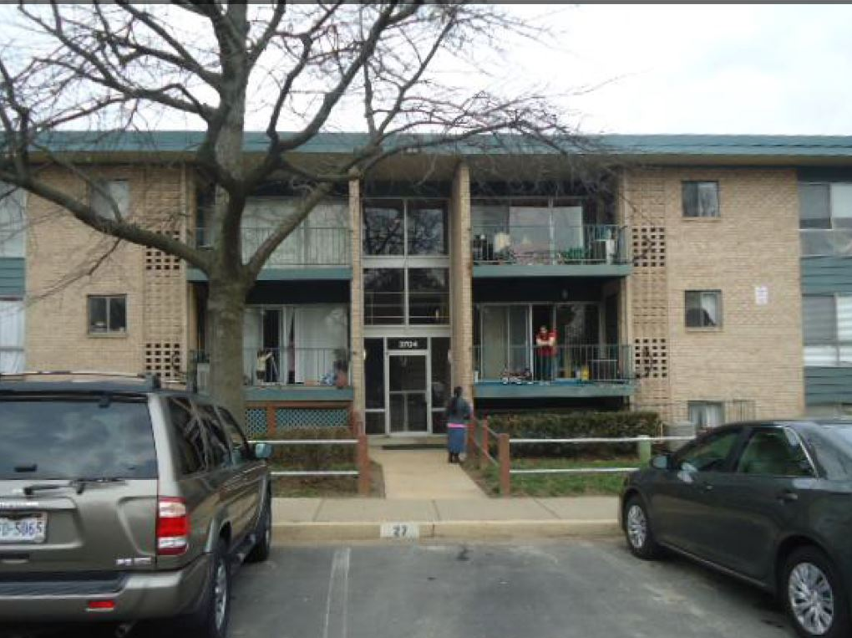
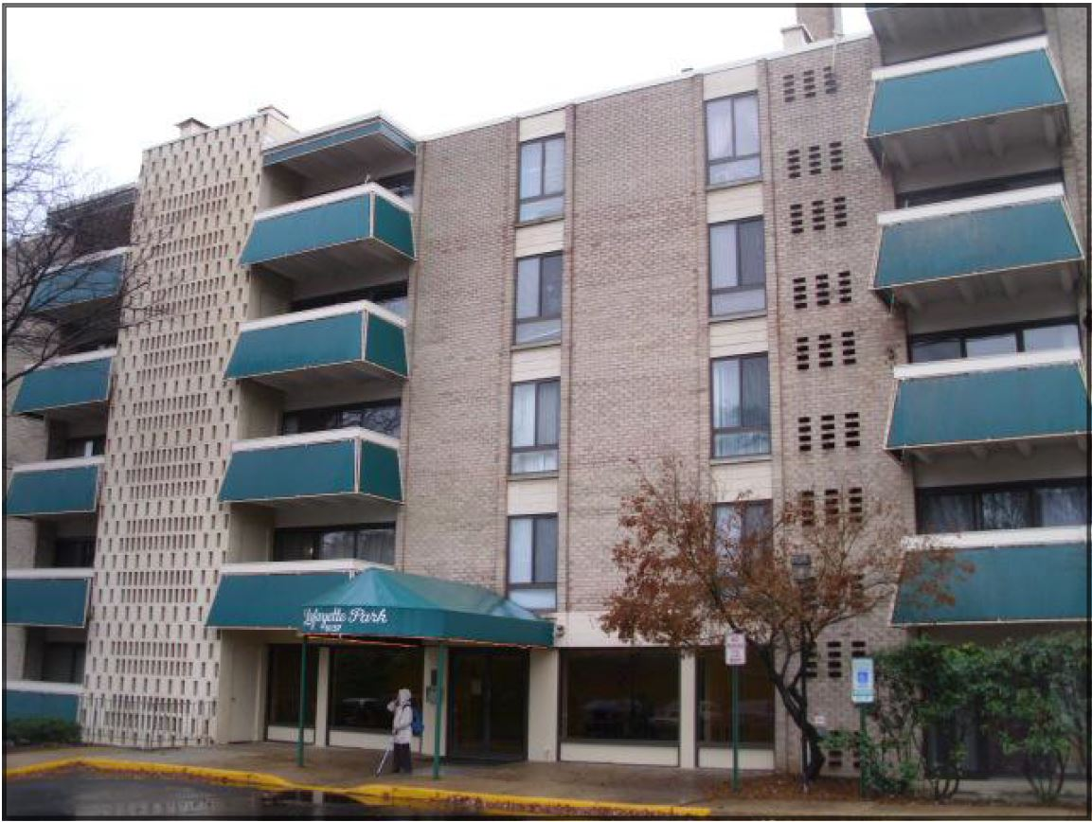
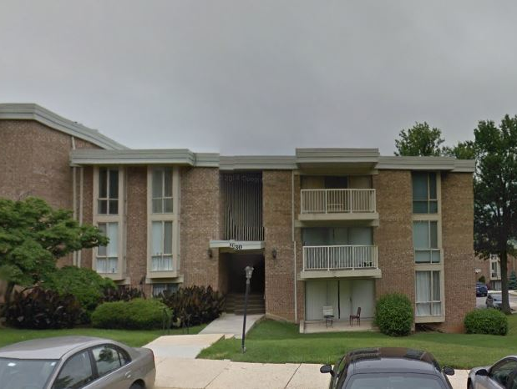
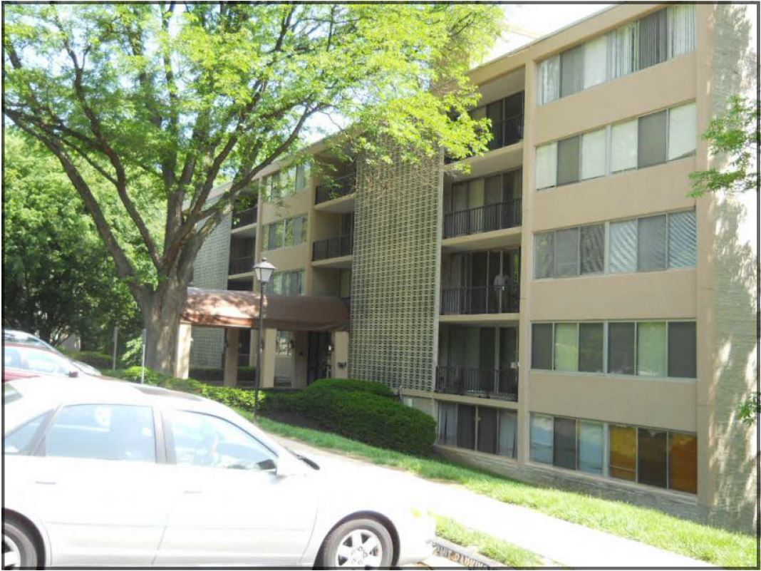
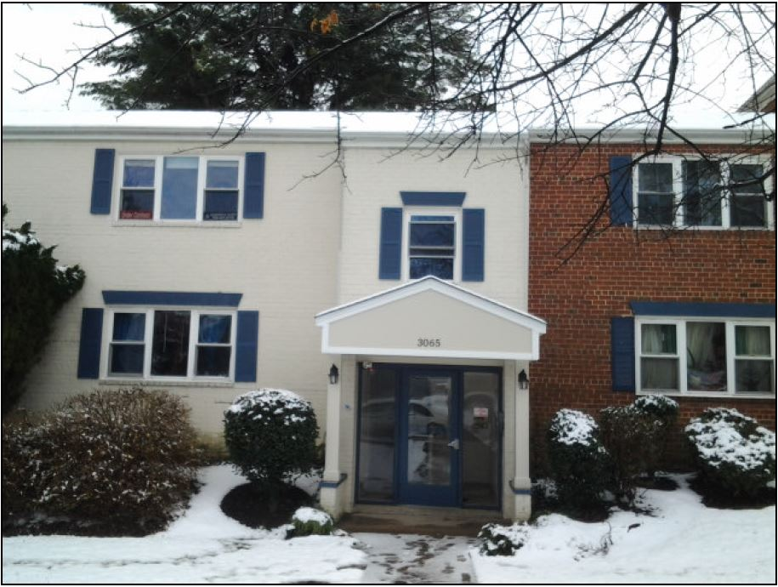
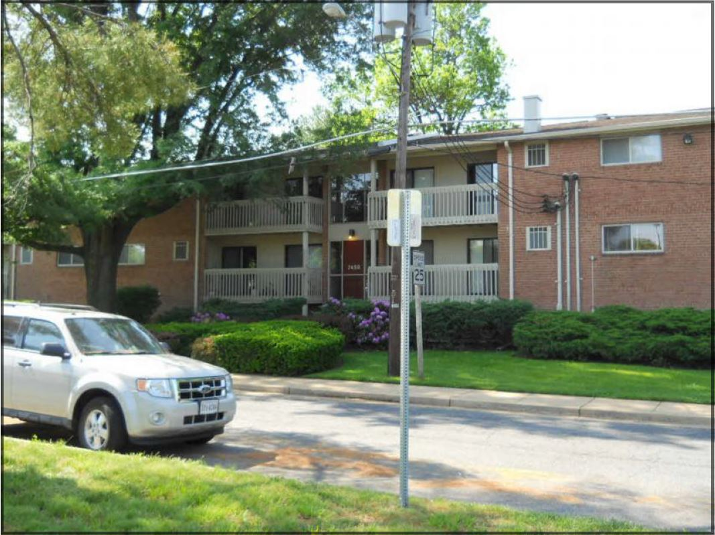
Who Do We Serve?
Notes:
New Home photos – Wagon, Leesburg Pike, -pull the white page to the front

Slide 7
467 Served

Slide 8
Consumer Satisfaction
375 surveyed in June, 2015 – 42%* response rate.
  97% feel their counselor is helpful to them.
  96% feel their counselor(s) shows interest and concern for me.
  96% feel their counselor(s) meets with me as scheduled, or reschedules with me as needed.
  95% feel their counselor(s) helps to explain documentation and paperwork related to the services I receive.
  95% feel Pathways helps me identify and explore more choices in my life.
  *7% increase in response over 2014. Standard is about 25-30%
Notes:
Standard response rate for surveys is about 25-30%

Slide 9
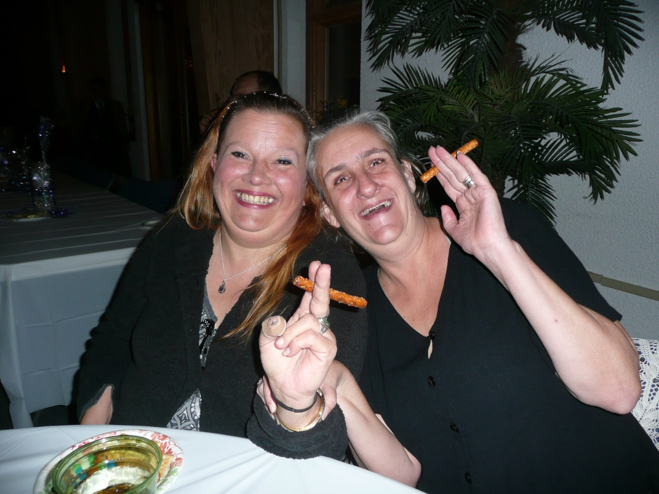
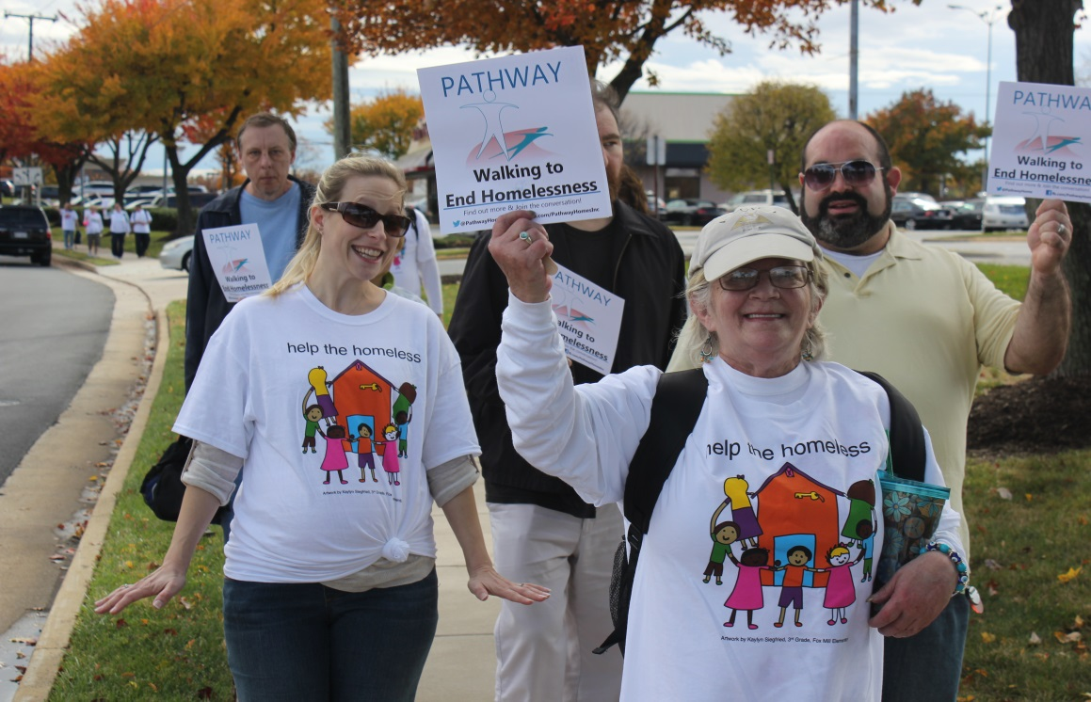
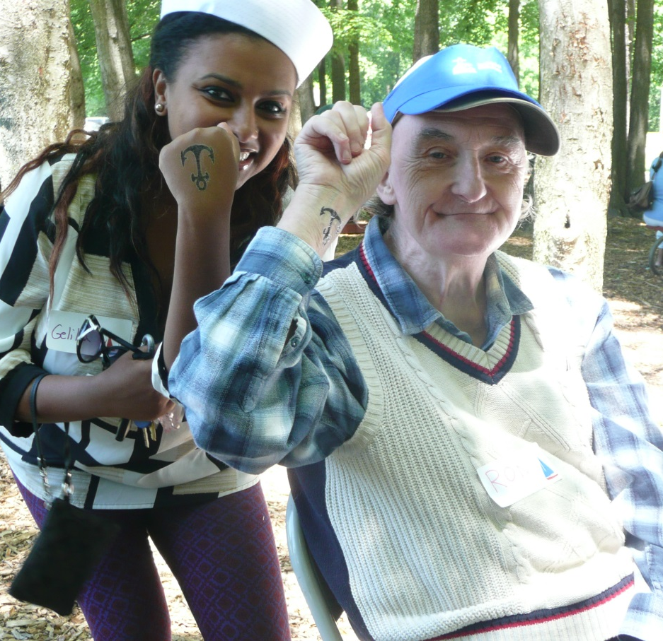
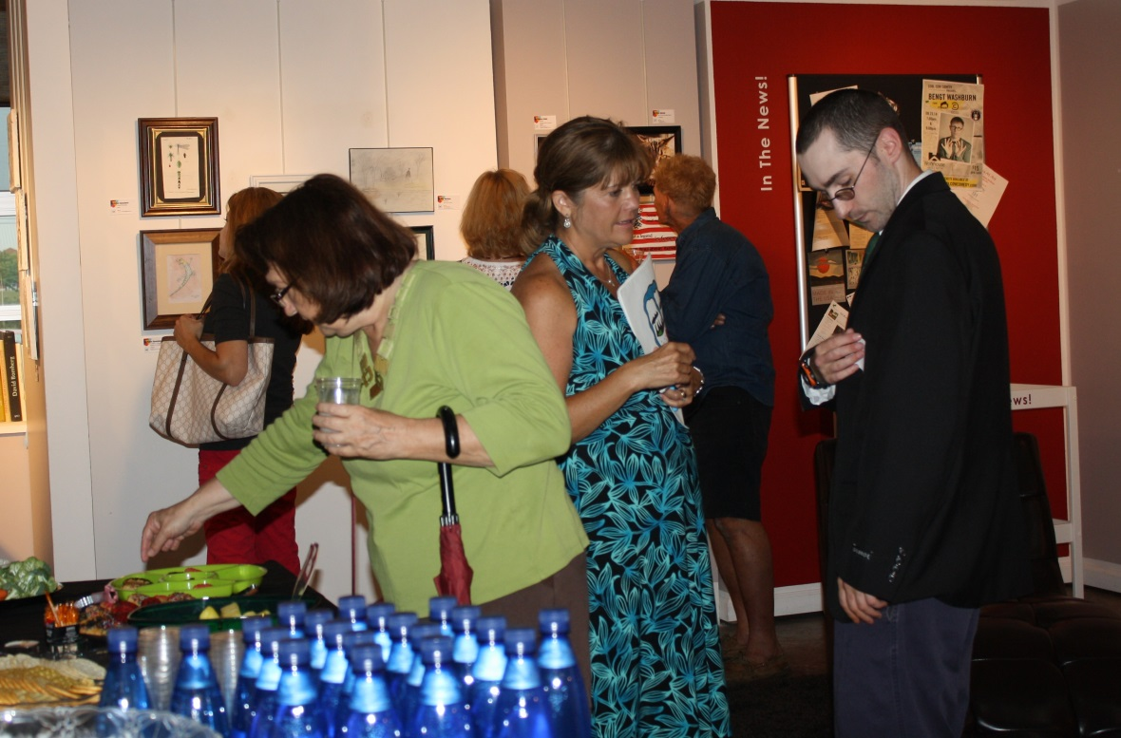
Notes:
CHANGE THESE PICTURES – resident holiday party, cookout, summer of the arts, help the homeless 2013

Slide 10
651 on Waiting List in FY15
Notes:
Waiting list differences between FY13 and end June 2012. Increase in most areas. Waitlist in 2012 was

Slide 11
Homeless History
*Male includes 1 individual identifying as transgender female to male

Slide 12
Axis I Diagnoses of Individuals Served
Note: the data on this chart is not presented as % as some individuals are duplicated across diagnoses.

Slide 13
Age (51 and Older)

Slide 14
Age (66 and Older)

Slide 15
Marital Status of Individuals Served

Slide 16
Veteran Status

Slide 17
Employment Status

Slide 18
Day Activity Status

Slide 19
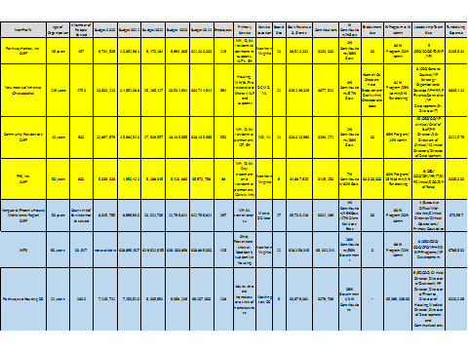
Benchmarking

Slide 20
Organizational Scan
Strengths
DSS, DBHDS licensed
CARF Accredited
Capacity to expand
Leading provider of residential supportive housing in the region
6th Best Non Profit to work for nationally
Highly skilled staff
Best practice and innovative models of care (Housing First, DBT, MI, Peer Support, etc.)
Community partnerships
Fiscal management
Stakeholder involvement
Program development and implementation
Acquisition & Development
Education & Advocacy
Best practice organization and develop supportive partnerships
Challenges
Highly specialized clinical base – need more training in co-occurring disorders.
Our population is aging in place
Baseline funding
Pathways continues to have a growing waitlist for services.
Ensuring adequate infrastructure for growth
Relative overdependence on public funding
Flat line funding and increasing costs
Maximizing operational efficiencies and effectiveness (i.e. HR)
Inflexible or unfair legislative mandates that impact service growth (MHSB, CM)
Profits are sufficient to sustain operations, but working capital continues to be a challenge in maintaining sufficient growth opportunities
Notes:
Education and Advocacy: Help the Homeless; Fair Housing; State Advocacy (Richmond)

Slide 21
Organizational Scan
Opportunities
Threats
Potential Funding (i.e. Medicaid, CSB) budget cuts
Aging consumers and staff
Salary disparity
MH/ID/SA Medicaid, Private Pay, HUD funding
Acquisition, Rental Subsidies
Fairfax, Prince William, Loudoun County CSBs, Washington DC, Central FL RFP’s
Volunteers
Information Technology
Philanthropic outreach
Public education and advocacy
Increase in licensed staff
Maximizing Efficiencies
Education and Advocacy

Slide 22
Strategic Goals
Increase housing stock and recovery-based services.
Maintain competent, qualified and satisfied workforce.
Market Pathway Homes as a best practice organization and develop supportive partnerships.
Ensure financial health and long-term viability of the organization.

Slide 23
Strategic Plan Objectives
Information Technology
Recovery
Growth
Human Resources
Communication

Slide 24

Information Technology
Transition to secure electronic health records.
Upgrade systems to improve communication.
Maintain hardware/repair computers timely.
Upgrade agency hardware/transition to laptops as appropriate.
Upgrade accounting software (Abila formerly Sage)
Implement Telework policy
Initial and ongoing training on IT security.
Develop email list for newsletters/solicitations
Conversion to VOIP telephone system.
Update agency website

Slide 25
Recovery
Continue to develop consumer-directed housing programs in community.
Create/expand volunteer positions in the agency that integrate consumers.
Create opportunities to support the “good life” for consumers.
Engage in community projects/activities to reduce stigma
Maintain Recovery Committee to implement recovery training to all stakeholders.

Slide 26
Growth
Enhance clinical skill base re: co-occurring multiple disabilities.
Develop programs that allow for step-down opportunities for current residents.
Sponsor new consumer-directed programs/restructure existing programs.
Expand public/private partnerships to develop new housing and supports.
Provide housing and/or support services to a total of 425 by 2016.

Slide 27
Growth cont’d
Maintain active involvement with OPEH.
Expand corporate, community, and county partnerships.
Increase agency personnel infrastructure as needed to adjust to changing needs.
Develop and implement a major IT fundraising campaign.

Slide 28
Human Resources
Form task force re: improving recruitment and hiring practices.
Expand opportunities for internal training for staff and management to include CEUs.
Shrink increased gap between comparable agency and county positions where possible.
Further senior level talent management and leadership development/succession planning.
Expand opportunities for agency program networking and team building.
Hire Major Gifts specialist philanthropy position.
Develop and implement Telework policy.

Slide 29
Communication
Educate staff about all agency programs and services.
Utilize IT improvements to streamline communication among staff.
Develop stakeholder email list.
Convert agency newsletter to electronic format.
Explore development of VOIP to allow direct dialing to staff extensions.
Explore development of agency video for You Tube or other media use.
Update agency website to increase attraction and ease of use.

Slide 30
FY 2015 Unaudited Financials
SUPPORT AND REVENUE
Government Grants and Contracts $8,531,571
Fees and Rents 1,335,752
Contributions 329,881
Sublease and Other Income 48,885
Interest and Dividends 1,149
Total Support and Revenue $10,247,238
EXPENSES
Program Services
24 Hour Residential Facilities $2,409,234
Supported Residential Facilities 5,363,305
Total Program Services $7,772,539
Management and General $1,742,188
Fund-raising and Development 15,843
Total Expenses $9,530,570
Change in net assets $ 719,749
Net Assets at the Beginning of the Year 7,722,998
Net Assets at the End of the Year $8,442,747

Slide 31
Notes:
Contributions: $160, 220
Direct fundraising
Grants
Expenses
- Cost of mailing

Slide 33
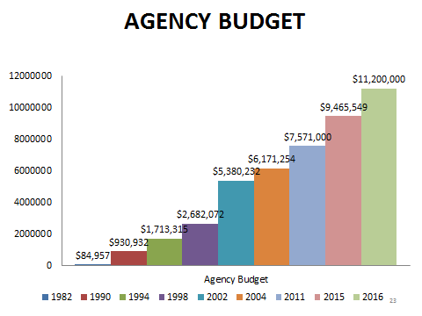

Slide 34
FY 2015 Fundraising
$200,000 in in-kind donations (estimated value)
90% increase in individual donations (2 one-time donations totaling $55,000 and Steps to Pathways Breakfast donation pledges totaling $120,000)
40% increase in total contributions
$30,000 in new corporate funding (Cafritz Foundation and Boeing)

Slide 35
Human Resources
Currently 119 Pathways staff members
36 hired during FY 2015
26 resigned; 12 (46%) completed exit interview
6 terminated
Reasons for leaving:
  Professional growth: 6 (unchanged from FY2014)
  More pay: 4 (2 fewer than FY2014)
  CSB position: 2
  Schedule:2
  Other 6 (graduate school, stress of job, interpersonal conflict, etc.)
Note: some individuals provided more than one reason for leaving

Slide 36
Employee Satisfaction
  November 2014: Nonprofit Times 50 Best Nonprofits to Work for in the US
    More than 10,000 employees surveyed across the US
    Small to large-sized non profits (Pathways – medium: 50-249 employees)
    49% response rate for Pathway Homes (5% more than in 2012)
    81-question survey
      25% organization overall
      75% employee engagement and satisfaction – workplaces experience and organizational culture (76 questions)
Pathways ranking: 6th (2015); 14th (2014); 28th (2013); 47th (2012)

Slide 37
Employee Satisfaction: Benchmark Report
Pathway Homes
Other Similar-Sized Non Profit
  96% Overall satisfaction
  95% Role Satisfaction
  93% Work Environment
  95% Relationship with Supervisor
  95% Leadership and Planning
  91% Corporate Culture and Communication
  85% Training, Development and Resources
  80% Pay and Benefits
  92% Overall Employee Engagement
  96% Overall Satisfaction
  91% Role Satisfaction
  89% Work Environment
  92% Relationship with Supervisor
  90% Leadership and Planning
  89% Corporate Culture and Communication
  81% Training, Development and Resources
  85% Pay and Benefits
  92% Overall Employee Engagement

Slide 38
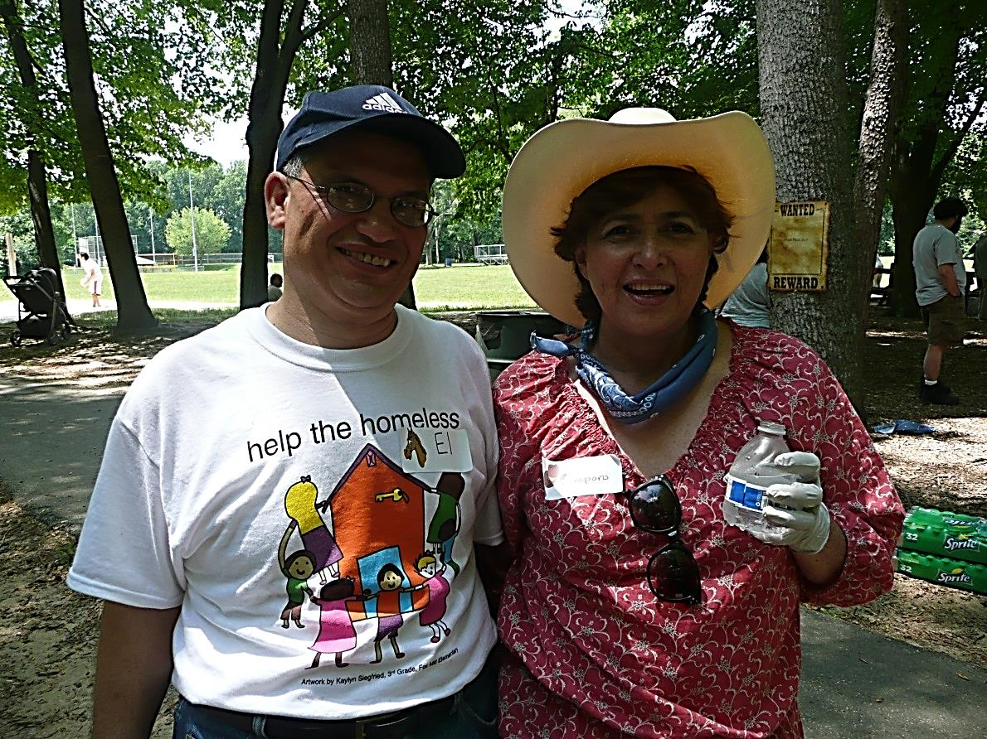
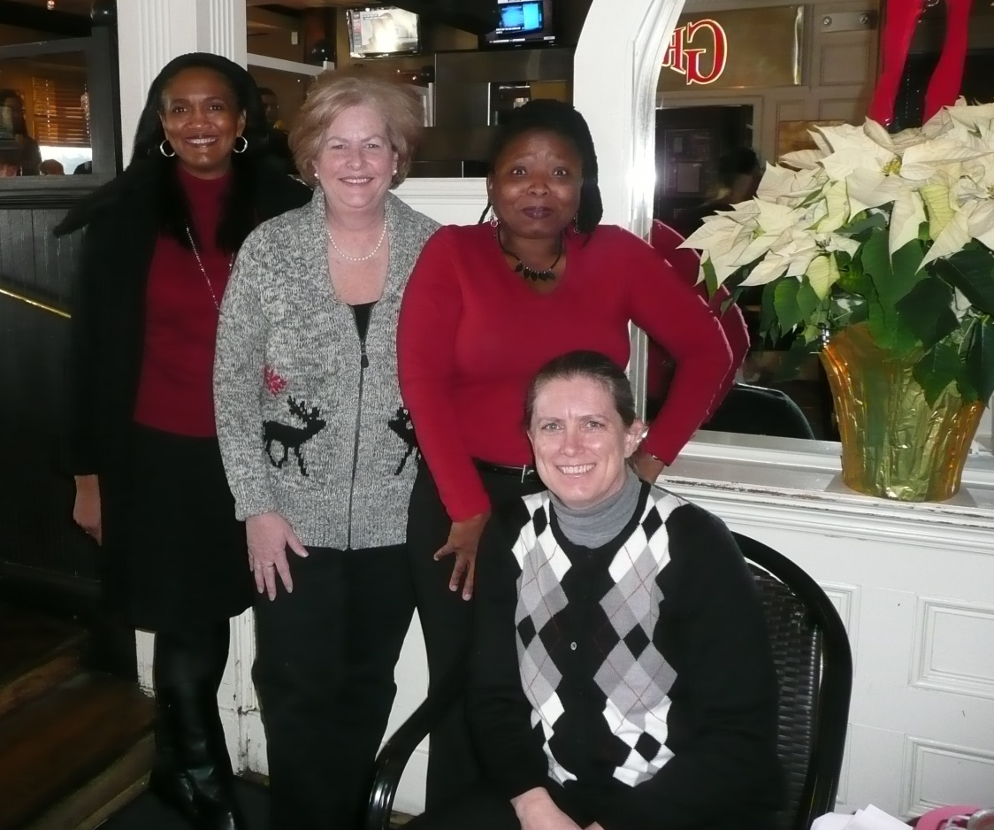
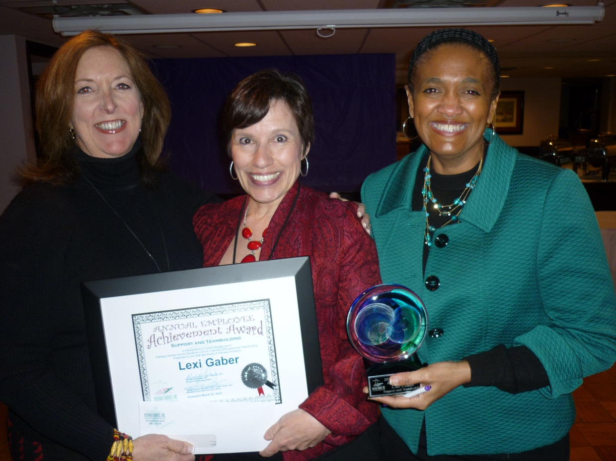
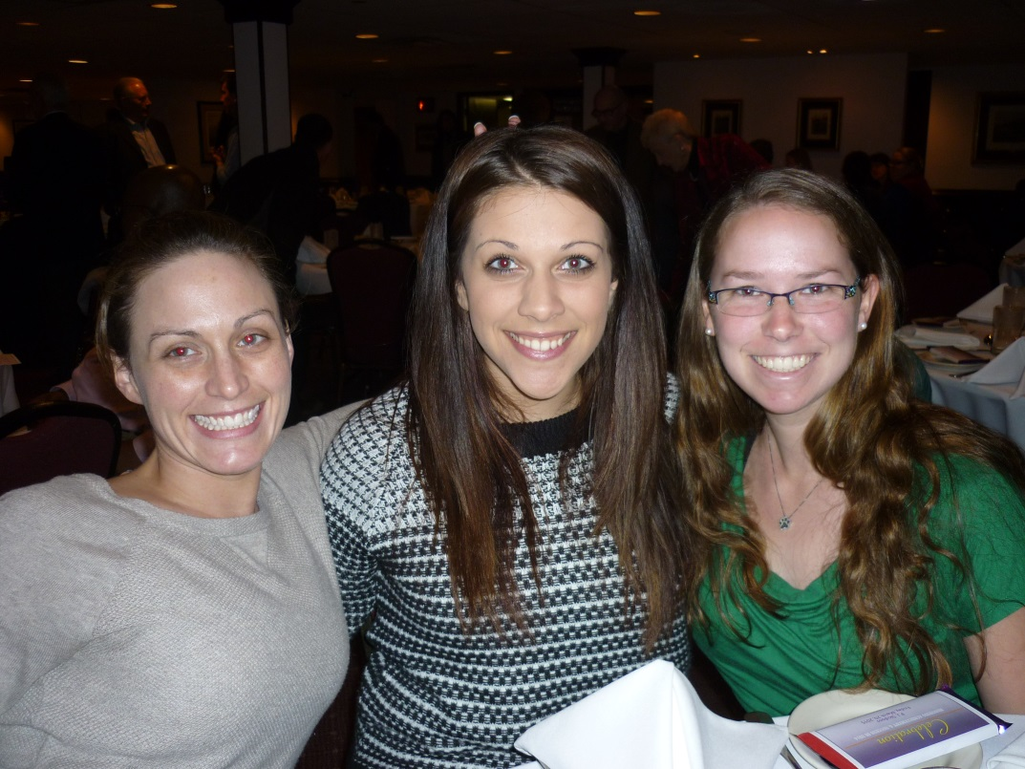
Notes:
Staff having fun

Slide 39
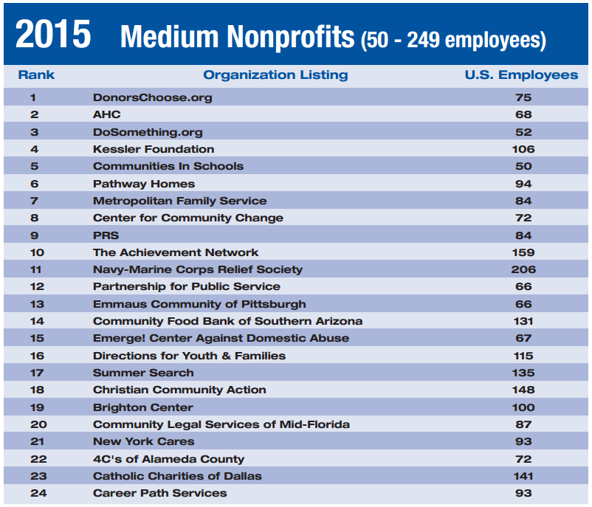

Pathway Homes was ranked 22nd overall, and 6th for Medium Organizations, employing between 50 and 249 individuals.
Notes:
Best Non-Profit to Work for in 2014 - CHANGE

Slide 40
Education and Advocacy
Staff serves as Vice Chair for the Virginia Association of Community-Based Providers (VACBP) group
Board participation at the local and state level with the Virginia Housing Coalition (VHC and VACBP)
Board participation at the Creigh Deeds Commission
Staff serves as co-chair of Fairfax Fair Housing Committee
Staff serves on Office to Present and End Homelessness Advocacy Committee and other CoC committees
Staff presented at Reel Abilities Film Festival
Monthly Steps to Pathways Seminars

Slide 41
Education and Advocacy cont…
Staff serves on the Fairfax Board of Supervisors to Fairfax Long Term Care Coordinating Committee (LTCCC) and Housing Sub Committee.
Staff participation at the Northern VA Aging Network Legislative Breakfast
Annual Help the Homeless Community Walks/Education
Fair Housing Advocacy
International presentation to University of Cyprus
Annual Summer of the Arts Exhibition
Ongoing anti-stigma efforts through presentations, articles, and social media
Quarterly In Roads newsletter

Slide 42


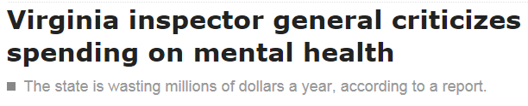


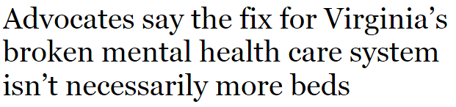
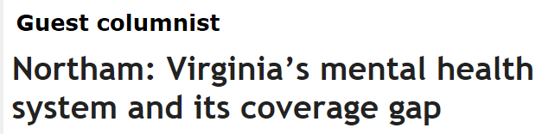
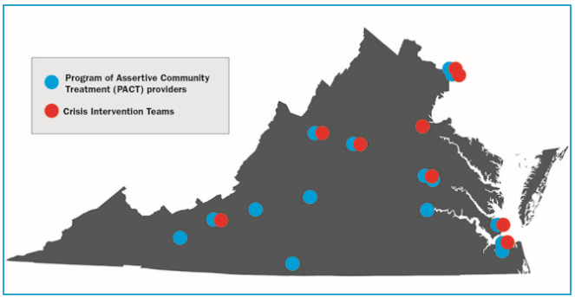



Notes:
VACBP – no cuts in MHSS funding; Creigh Deeds; Jennifer picture?; Navy Yard incident?, VA Tech incident, homelessness?

Slide 43
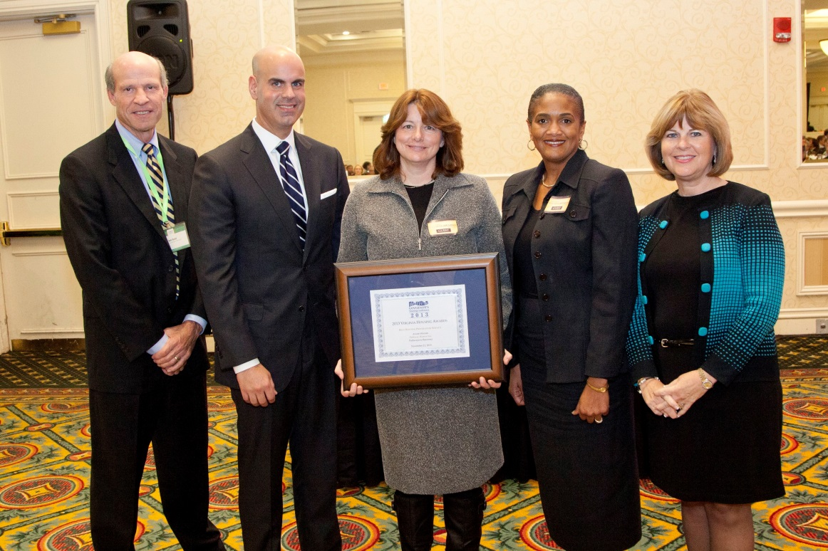
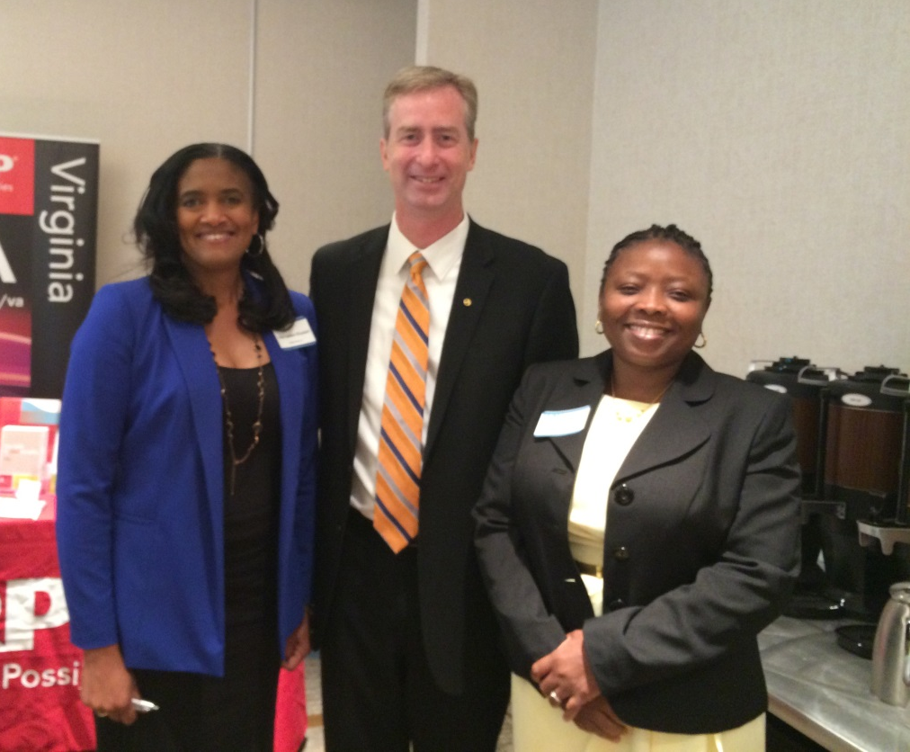
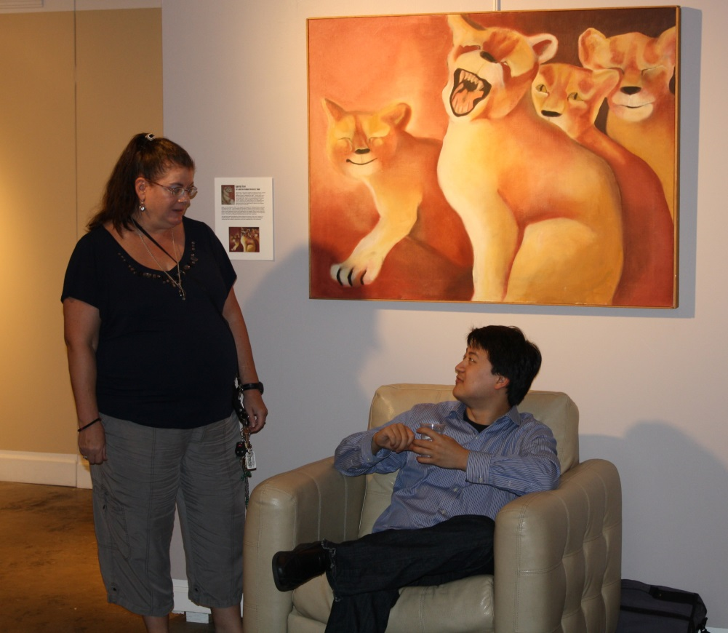
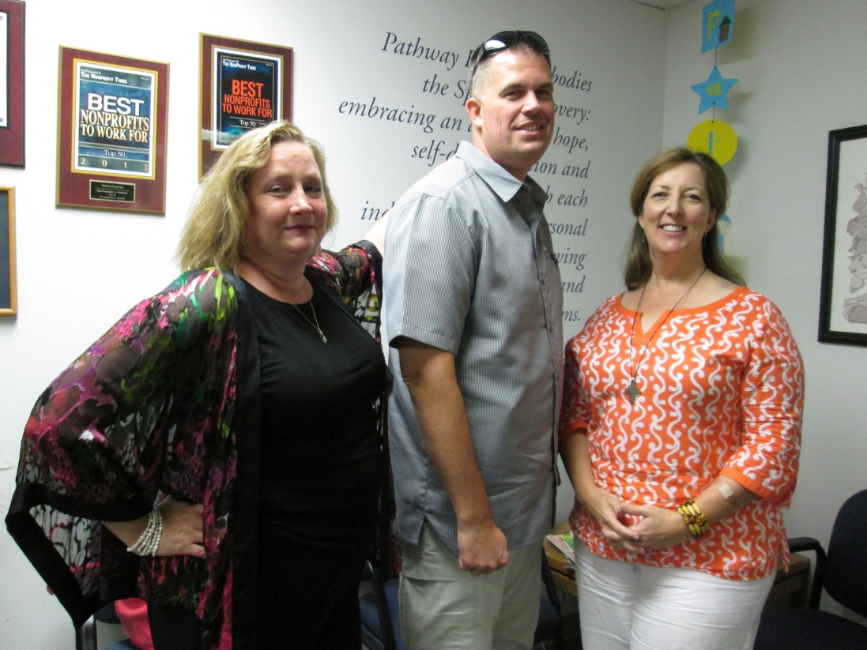
Notes:
Advocacy Pictures

Slide 44
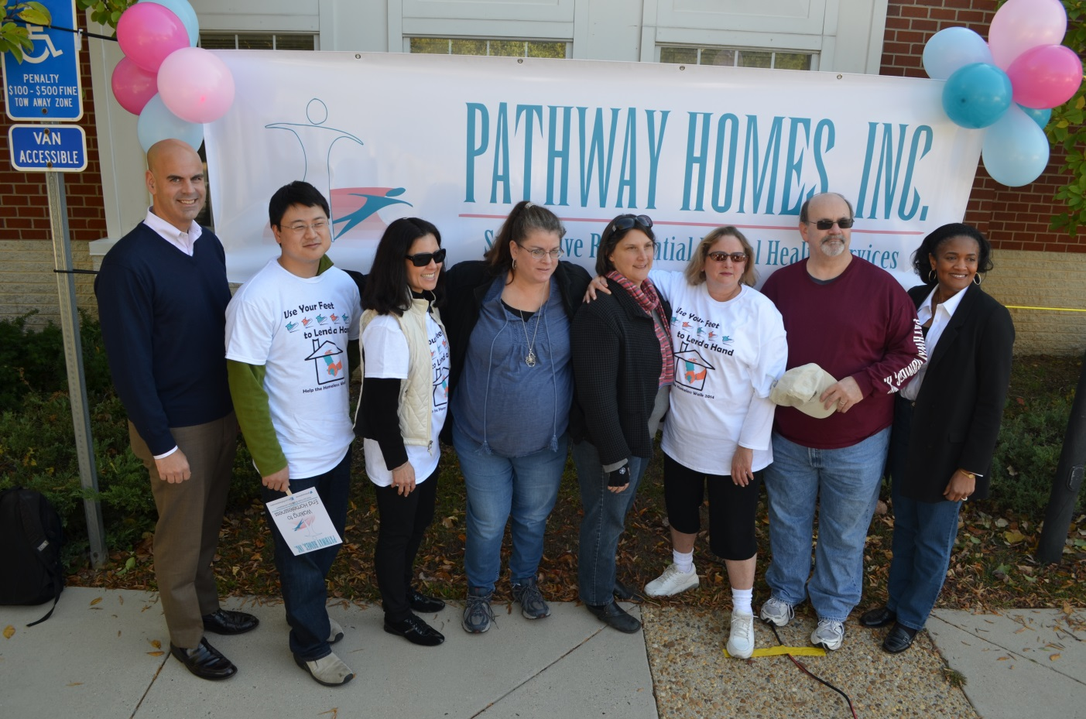
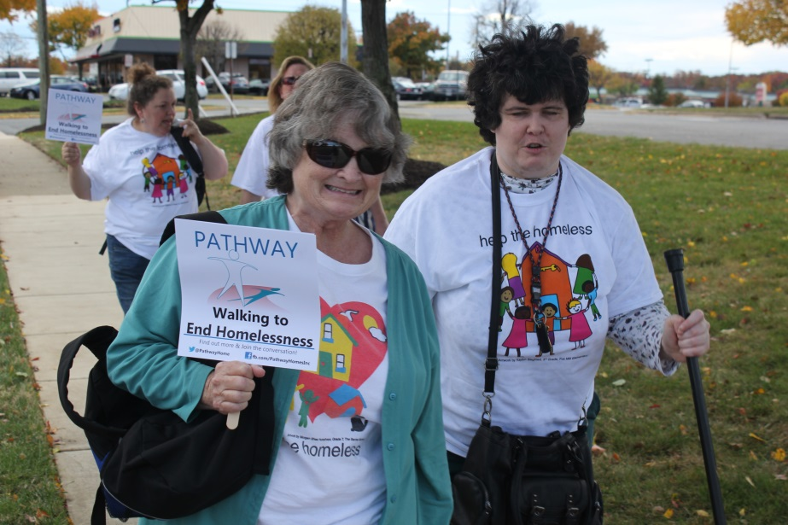
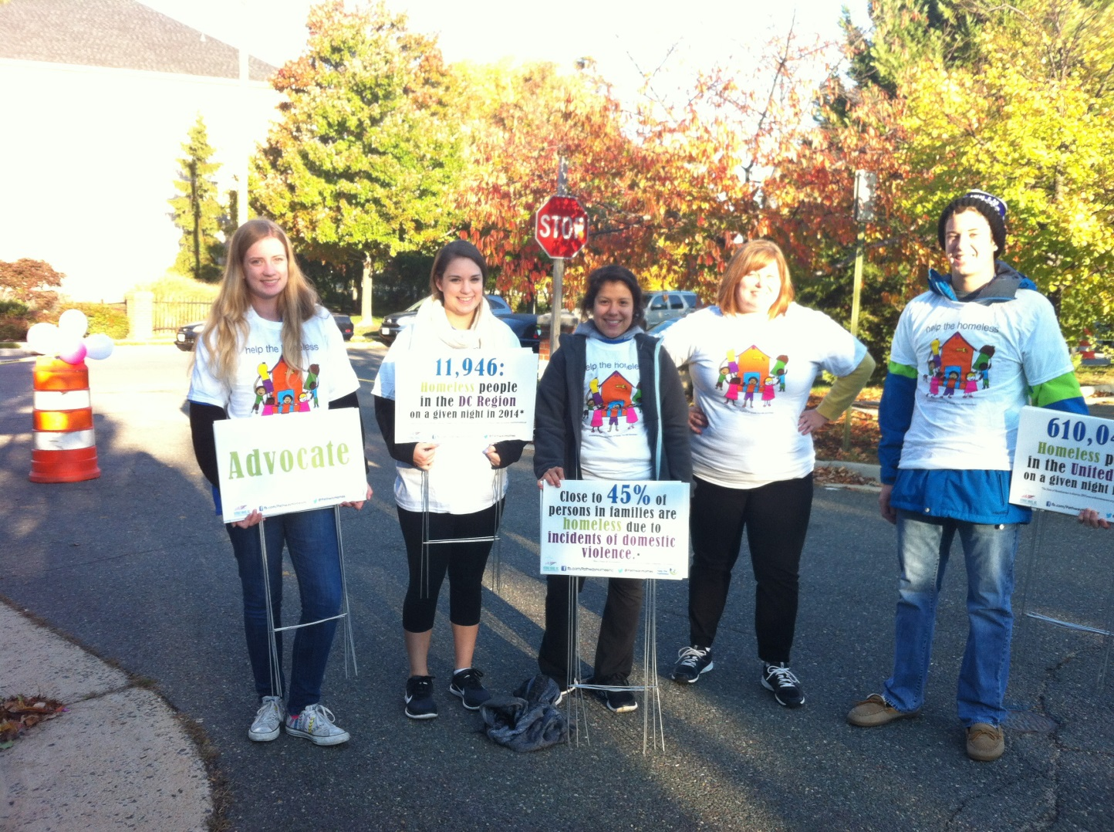
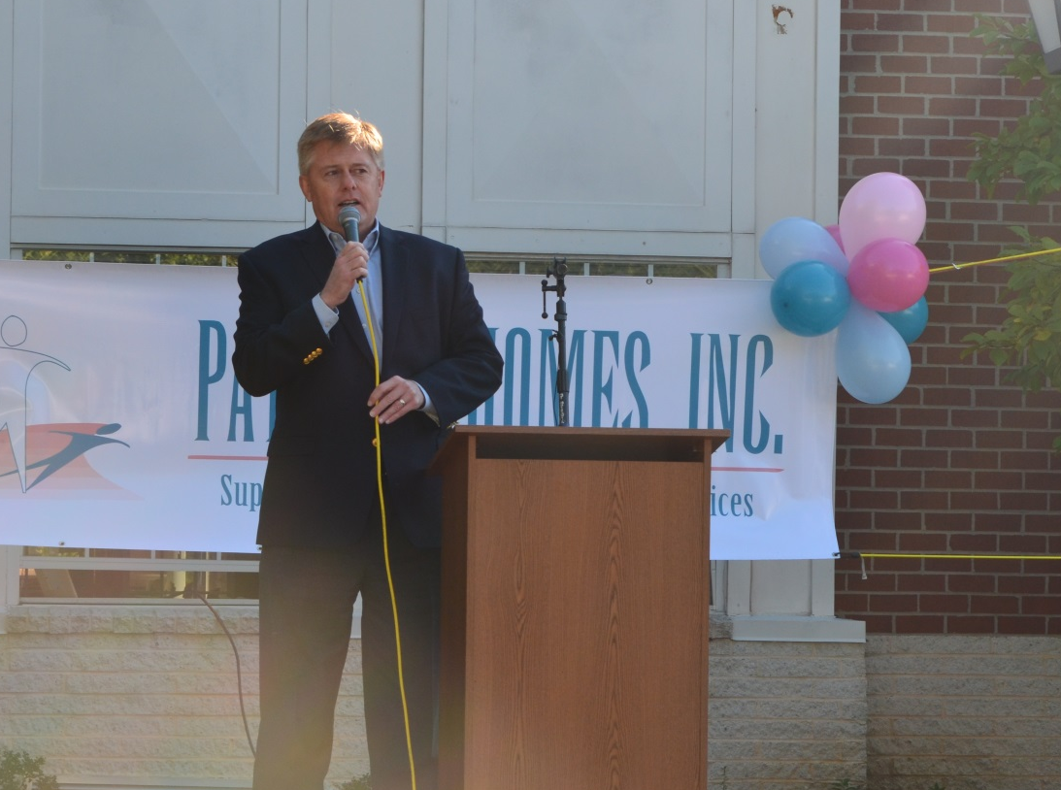
Notes:
Help the Homeless 2013

Slide 45
Year End Highlights
Ranked 6t^{h} on The Non-Profit Times 50 Best Nonprofits to Work For 2014 list.
Secured largest one time HUD contract in the region of $1.2 million to serve 55 individuals who are chronically homeless with SMI
Opened 1st ALF for individuals with mental health disabilities in Prince William County
Purchased 2 new townhomes for supportive living- Prince William County
Created new legal entity to began expansion efforts in Central Florida

Slide 46
Year End Highlights
Renewed 5 year contract- Stevenson Place ALF and added a 37th bed.
Added 5 new homes to Pathways housing stock.
Received approx $4.2 million in county and federal awards and renewals.
Completed 4th CARF Accreditation- with no reported recommendations

Slide 47

Looking Ahead
Service & Health Care:
  Reduce waitlist
  Extend services regionally/nationally
  Ensure evidence-based service delivery
  Eradicate homelessness among those with mental health disabilities and co-occurring disorders in Fairfax-Falls Church Community so that access to housing and support services are available within weeks instead of years.
  Acquisition & Development
  Ensure maintenance of existing properties
  Increase housing stock to 100 homes by 2020

Slide 48
Looking Ahead
Education & Advocacy:
  Local, State, and internationally.
  Ongoing presentations, articles, and speaking engagements.
  Ongoing anti-stigma campaigns.
  Create new legislation to ensure parity, case management service funding, and a competitive marketplace for private providers to compete and drive down costs while increasing quality and efficiencies
  STRATEGIC PLANNING 2016- KICKOFF

Slide 49

You are an Awesome Board…..Thank You!!
Looking forward to the year ahead!

