Slide 1
Technology at Pathway Homes
Presented by Lauren Leventhal & Brian Samson

Slide 2
Objectives
The way things were
How Pathways currently uses IT
Efficiencies realized
Resident homes and staff offices
Credible
Communications
Board Portal

Slide 3
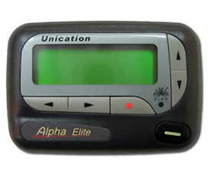
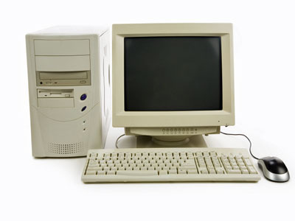
The Dark ages
Notes:
5 years ago, many Pathways employees were working with 10 year old computers, and juggling piles of papers and charts. Essential staff often carried pagers in addition to cell phones.
After the Board made IT a priority, we were able to move forward with Credible, Abila/SAGE, and providing staff with the equipment they needed to do their jobs.

Slide 4
Moving Forward
GoLive with Credible June 6, 2011
GoLive with ABILA (SAGE) July 2011
Transition to VoIP December 2012
Adoption of Box.com October 2014
Installation of secure doors (Summer 2015)
Notes:
Pathway Homes has been able to adopt several cloud-based technologies that enable the agency to function better and more efficiently.
Credible is our electronic health record system designed specifically for behavioral healthcare. Abila is funding software geared toward non-profits.
Broadview Networks is a voice over ip phone system that provides phone systems not only for the administrative office, but also the Russell Road assisted living facility and the Florida office.
BOX.com is HIPAA compliant cloud-based file storage.
Relias Learning Management System is online training platform.
Kastle systems installed electronic locking mechanisms on the 3 non-primary doors in our office. Helps to be able to monitor security and prevent back-entrances. All staff in the office and MHC IIs in the field have been provided with key fobs for access.

Slide 5
Efficiencies
Caller ID
Direct-dial extensions
Easier communication between distant locations
Emergency preparedness
Web-based access provides access to information
Notes:
Previous system was hosted within the building and did not allow for direct dialing or remote access to the routing structure.
Broadview allows us to control call routing remotely (better communication during emergencies or weather-related closings).
When power is out in the building, phone system is hosted elsewhere and can collect voicemail. Extended outages could be re-routed to cell phones, or other phone number within the agency = better disaster-preparedness.
Ease of use = closer communication with Russell Road and Florida offices (extension dial)
Ability to identify incoming calls/numbers (Russell Road incident) even when not at the office.

Slide 6
Efficiencies
Added to our account in October 2014 after renegotiation of contract.
Saved $125 per month over existing price structure while gaining 6 Box.com licenses
Transfer of files securely
Collaboration without paper
Access to files without access to server
Notes:
Currently use BOX.com in various situations, including passing confidential information. Use Box.com to send documents too large to email.
Recently begun to use Box.com for team collaboration (compiling the newsletter).
Prince William County sends/receives information about Russell Road residents through Box.com. We also use Box to help with teleworking, which wasn’t possible before Pathways made IT a priority.

Slide 7
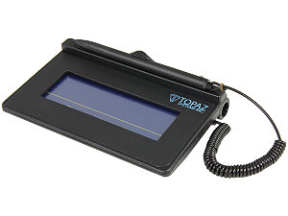
Efficiencies
Ease of use
Access from wherever – whenever
Adaptability
Centralization
Collaboration
Notes:
Web-based, so generally staff and auditors feel comfortable using the software. (CARF surveyors have appreciated ease of use). Training staff on the basics is not necessary since it works with links and buttons like any webpage.
Ability to telework. Staff could not previously easily complete this. Able to access information from anywhere with internet access. Provided with laptops, scanners, signature pads, etc. Supported living staff equipped with iPhones to enable hotspot usage (internet access in consumer homes!)
Adaptability = able to mold the system to our needs. Changes are not a huge process as long as we train staff.
Information is held in one database, rather than multiple databases at once.
Credible Conference = savings of $2,250 by presenting two different topics at the Conference:

Slide 8
Efficiencies
Getting the whole picture
Credible Conference ($2250 savings)
Notes:
Credible has allowed us to better report on outcomes by keeping information in one place.
*robust reporting capabilities
*flexibility of the system allows for better tracking of what WE need to track (using BedBoard to track vacancies, annual agency outcomes, etc.)
*Collaboration within the agency (administrative certification share information with clinical staff)
*communication among staff (instant messaging, etc.)
Invited to give two presentations at the Credible conference 2 weeks ago. Maximizing Credible – A Partner’s Story; Small Agency Best Practices

Slide 9
Efficiencies
Year-to-date savings:
of $1,164/month for cable
$86/month for cellphone vacancies
Receive gift cards worth between $250 -$300 per converted account
Free internet upgrades from 50/50 Mbps to 75/75 Mbps for the rest of the 2 year contract
Reimbursement from over-charges for cable TV equipment's off $1229.07 or more.
Notes:
In 2014 we started transitioning our cable, voice and internet provider from residential accounts to business accounts. We began the transition in order to have more control over our accounts and to eliminate legacy accounts created when the agency was much smaller. In the process, clinical management team decided that the agency would no longer provide phone, cable or internet to residents of non-group homes. This is a recovery-based process since your landlord would not provide these utilities for you.
Transition is made after renegotiation and/or transfer from one service provider to the other (in order to get the best ‘deal’)

Slide 10
Looking Ahead
Video Conferences/Webinars
Lunch ‘n’ Learns Summer 2016
Making more use of our website
Portals
Employees
Board
CSB Supervisors (Deployed Contract)
DBHDS (Pathways to Stable Housing)
Notes:
For lunch ‘n’ learns over the summer, the Board requested the option to attend via web conference. We will be able to offer this as an option.
Board portals are now common for various projects. We have moved over from one login to individualized logins because it is best-practice (more security in locking someone out, being able to track logins, etc.)
We will be creating individual logins for Board members shortly after this meeting. Brian will give a brief overview of the Board Portal.

Slide 11
to the Board for your continued support of IT at Pathway Homes!
Notes:
For lunch ‘n’ learns over the summer, the Board requested the option to attend via web conference. We will be able to offer this as an option.
Board portals are now common for various projects. We have moved over from one login to individualized logins because it is best-practice (more security in locking someone out, being able to track logins, etc.)
We will be creating individual logins for Board members shortly after this meeting. Brian will give a brief overview of the Board Portal.

